Slide 1
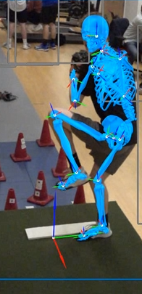
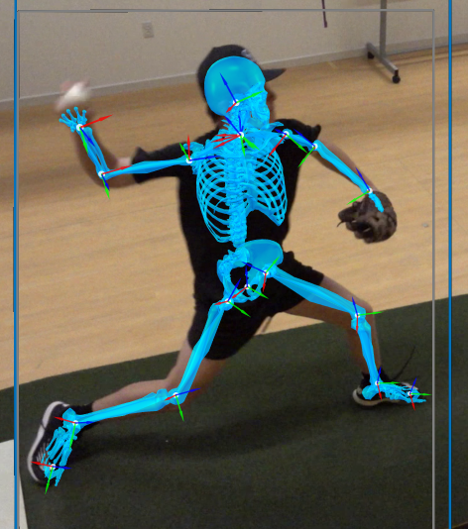
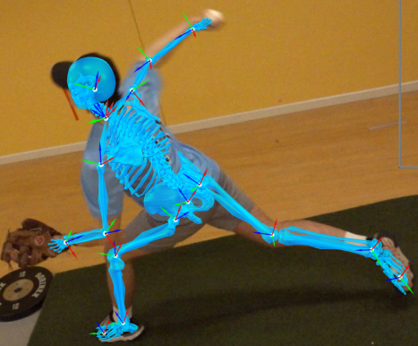
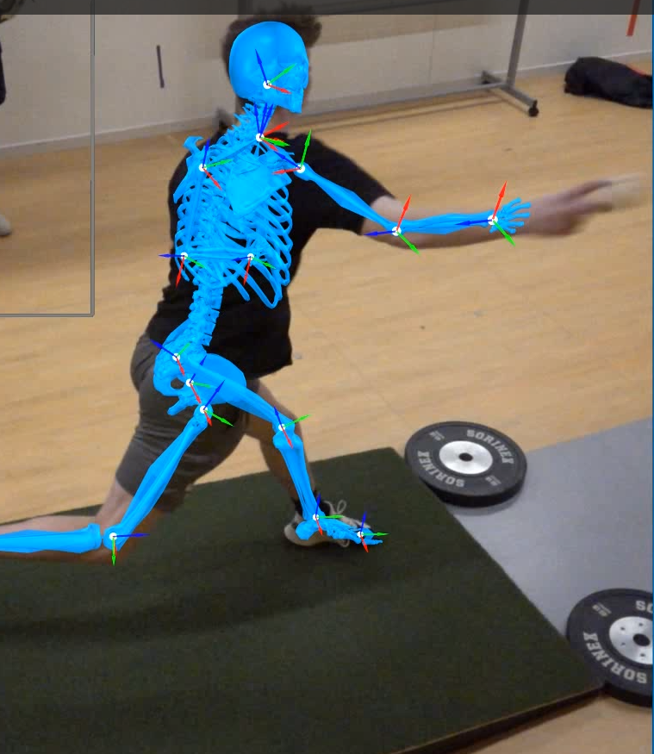
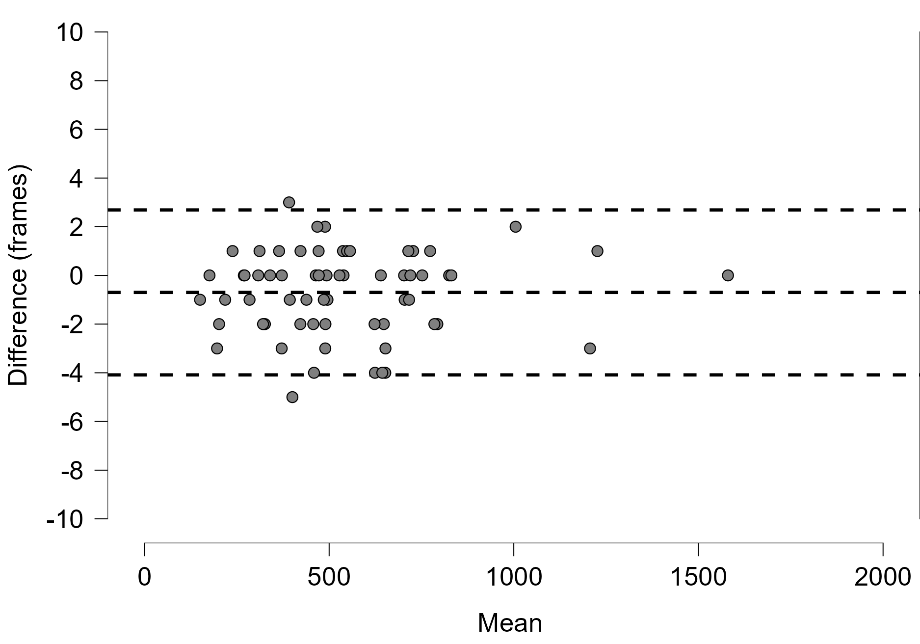
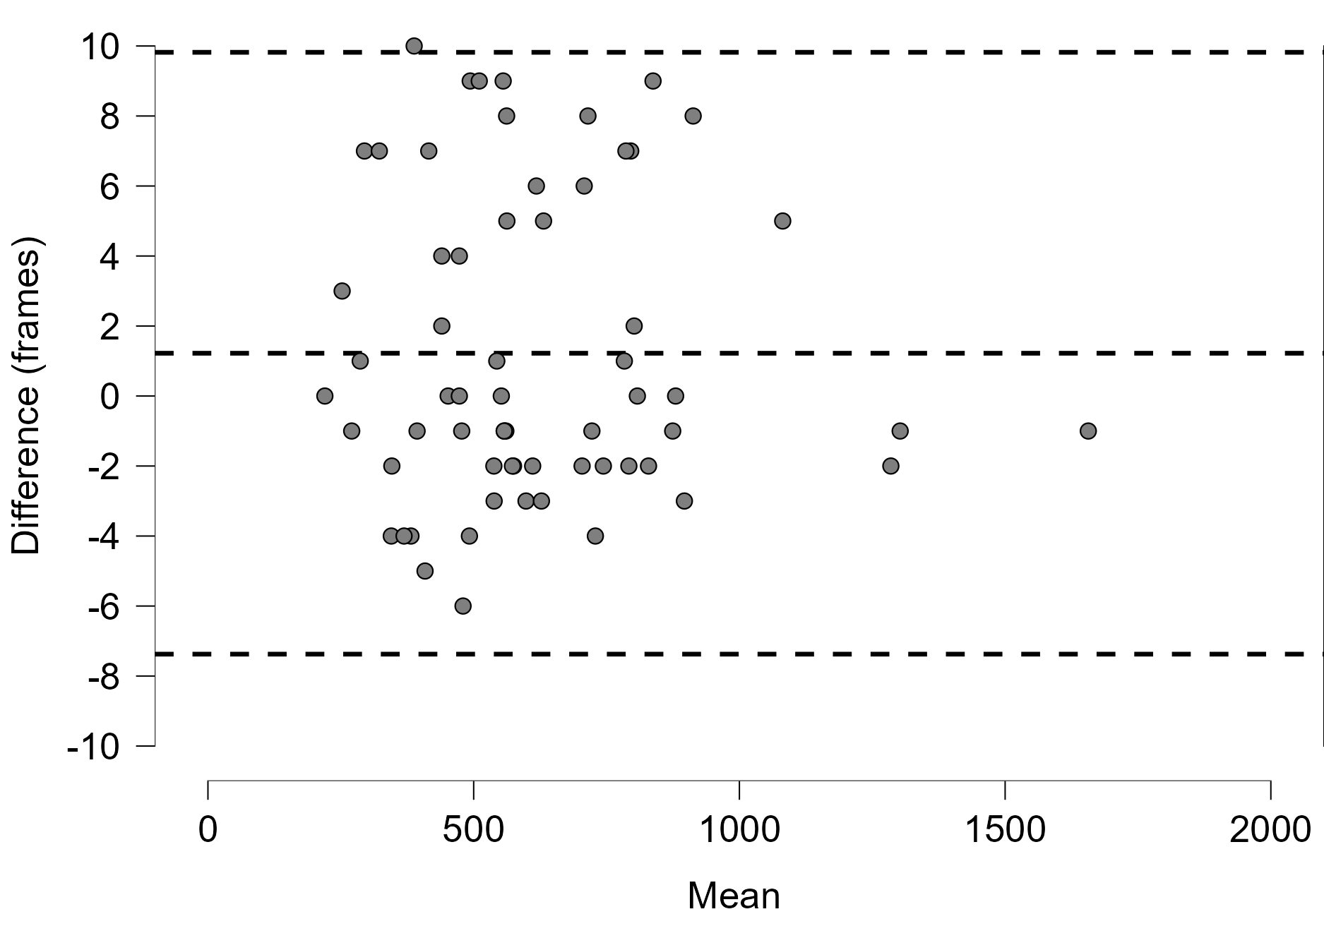
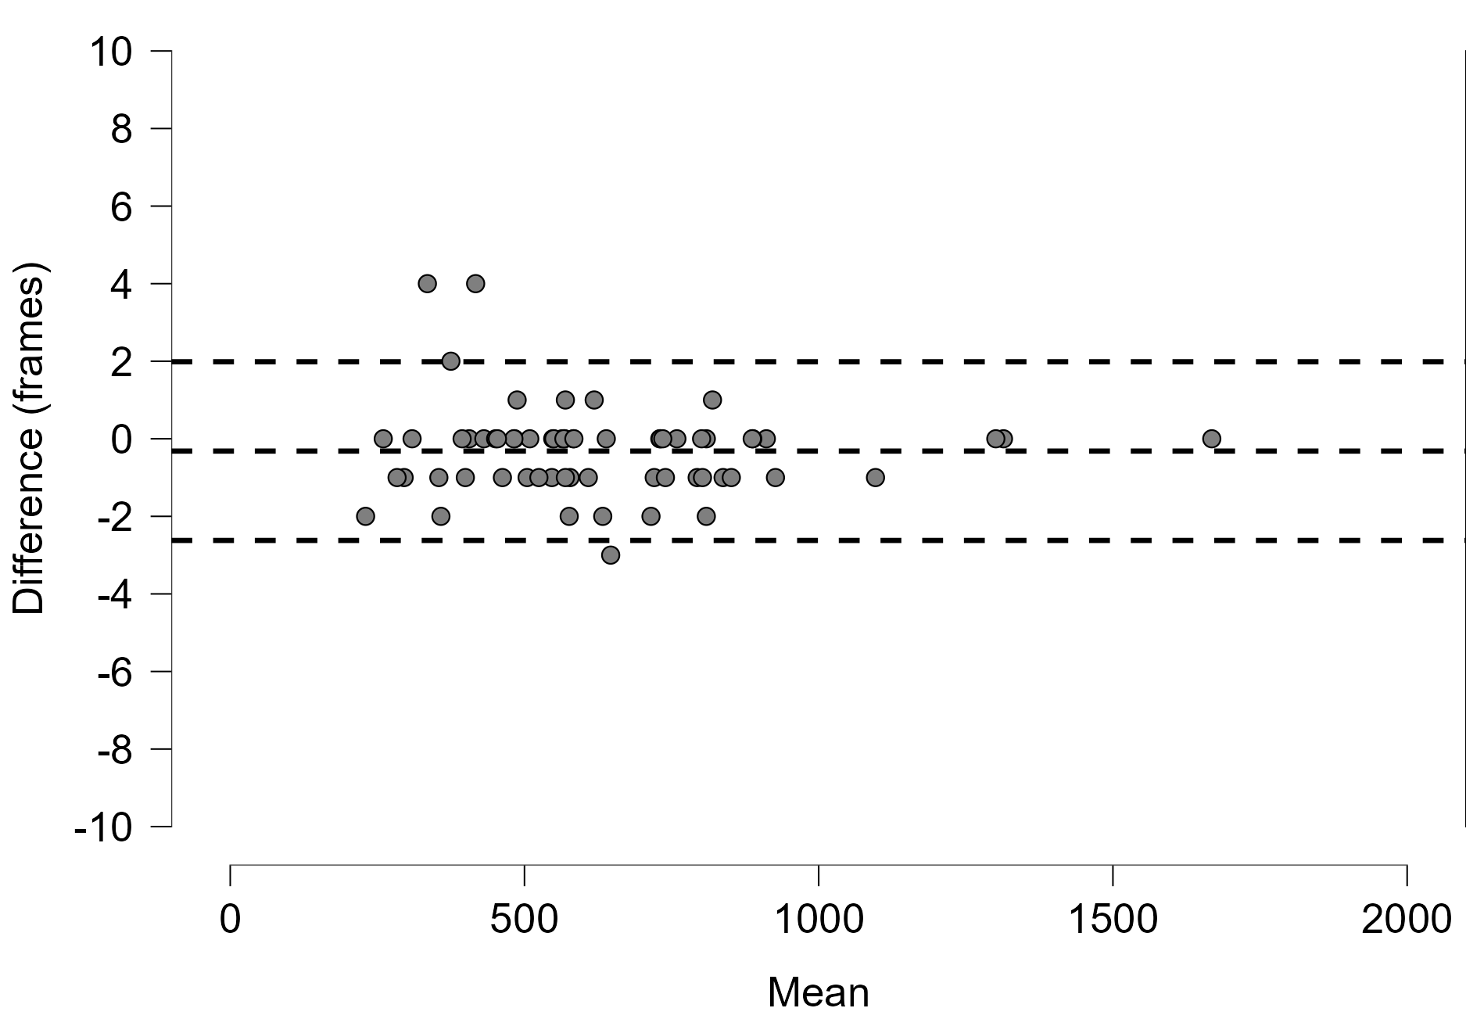
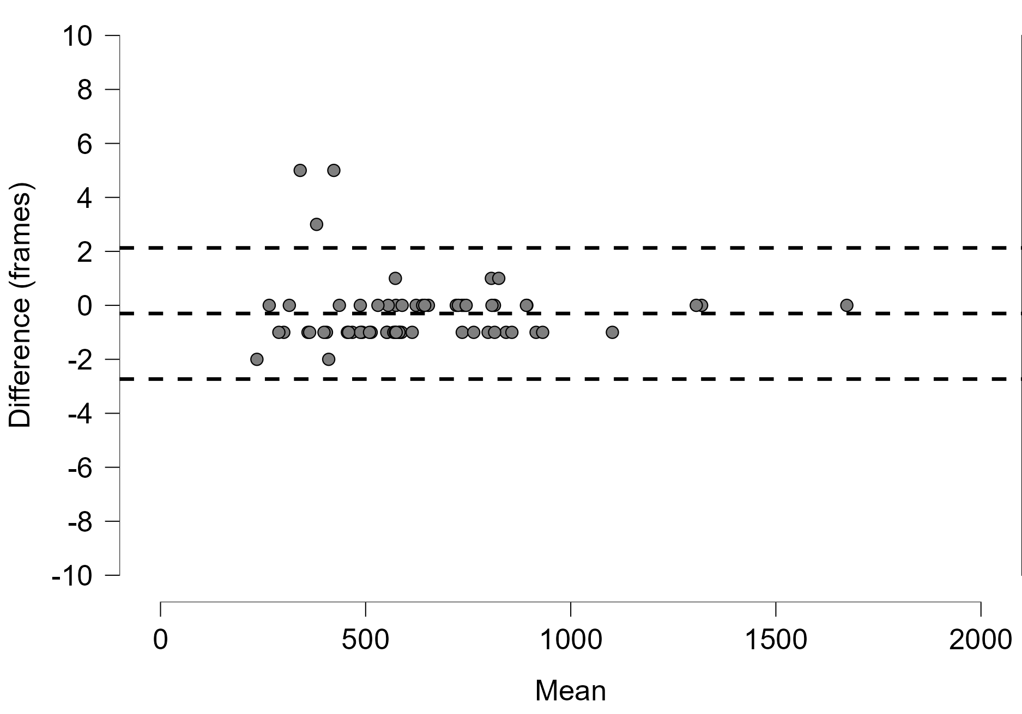
Can Markerless Motion Capture Software Consistently & Reliably Auto Detect Important Pitch Event Markers For Baseball Players?
Jenna Engels, Jaqueline Lage, Sarah Mandelkow [Mentor: Jonathan Hudak]
College of Health Professions
Department of Physical Therapy and Human Movement Science
ABSTRACT
Markerless motion capture systems offer promising data for analyzing athletic performance with high precision; however, the camera systems utilized as part of the Pioneer Performance Center have not been tested with higher speed motions. Theia 3D software, mainly used for gait analyses previously, was utilized to examine the effectiveness of the SONY RX 0II camera system and consistency of identifying key event markers during fast moving motions, such as pitching.
A specialized pipeline was developed to auto detect the frames corresponding to 4 different important event markers: maximum hip flexion, foot touchdown, late cocking, and ball release. The automated data generated by this pipeline was compared with manually identified event frames to assess both accuracy and precision.
Videos were captured at a rate of 120 frames per second, which is slower than other facilities collecting baseball kinematics. Notably, only fast balls were thrown during data collection sessions, with an average velocity of 75.9 miles/hour. No pitches were thrown with maximum effort due to the time of year the data was recorded.
The groundwork laid thus far has provided a solid foundation, regarding the pipeline. As more pitchers work with the Pioneer Performance Center, the pipeline will undergo further refinement and optimization to accommodate a diverse range of pitching styles and techniques, ensuring its effectiveness for all participants. Ultimately, the purpose of this study is to internally validate the data and pipeline to be used with more baseball players in the future.
RESULTS
DISCUSSION
The markerless motion capture system is typically used to identify initial foot contact by marking the frame where center of mass vertical displacement approaches zero. When analyzing event markers with baseball pitchers, the pipeline had to be adjusted to identify different event markers and kinematics. Specifically, due to the forward trunk lean during a pitch, center of mass motion would not correlate with foot contact, making velocity of the lead foot a potentially viable alternative. Additionally, pitchers can demonstrate different landing strategies (toes first vs. heels first) making autodetection challenging.
Reliability of detection of each event marker is represented in Figures 2-5 on a Bland-Alman plot which shows the mean of each event marker in relation to the difference between frames. As shown in Figure 3, foot touchdown has data farthest away from zero because this event marker has the largest standard deviation of 4.37. The system had trouble picking up reliable foot touchdown event markers because, in running gait, the center of mass is almost 0 once the foot makes contact; however, this was not the case in baseball pitchers.
Figures 4 and 5 show that the late cocking and ball release event markers had data points closest to zero as these were within 1.8 standard deviations from the mean, despite the cameras’ inability to detect objects. Both motions are correlated, since ball release was set five frames past external rotation; therefore, the markerless motion capture system was reliable when detecting both late cocking and ball release.
Figure 1: Visual representation of the 4 event markers from Visual 3D auto detection.
 | Maximum Hip Flexion | Foot Touchdown | Late Cocking | Ball Release
Visual 3D
Maximum Hip Flexion Reliability Chart
Figure 2: Comparison of the difference in the number of frames between the visual method and Visual 3D auto detection for maximum hip flexion
Foot Touch Down Reliability Chart
Figure 3: Comparison of the difference in the number of frames between the visual method and Visual 3D auto detection for foot touch down.
PARTICIPANTS
20 members from a local baseball pitching development program
The average age of the pitchers is 15.5 years old, average height is 1.77 meters, and average weight is 75.8 kilograms.
TAKE HOME MESSAGES
The purpose of this data analysis was to determine the accuracy and reliability of the markerless motion capture system in identifying pitching event markers to internally validate the system for future work with baseball pitchers.
The markerless motion capture system has proven to be reliable when used for identifying event markers with baseball pitchers.
Ball release and late cocking were the two most accurate event markers between the visual method and V3D auto detection whose standard deviations were very close to 1.
The largest average difference in frames is 1.44 for the foot touch down event marker which is a good focus point to improve upon in the pipeline. How to identify the foot touchdown since the average difference in frames and time, standard deviations, and standard error of the mean were significantly higher for this event than the other event markers.
This helps to show that markerless motion capture and V3D auto detection can be used to expand data and knowledge for other sports and positions, besides just gait.
METHODS
Each of the 20 pitchers pitched 10 times; however, only the first 3 pitches from each pitcher were used.
The cameras used included an 8-camera setup of Sony RX 0II cameras (120 frames per second).
Visual method: Data was collected by manually looking at each frame of the videos in Theia 3D software and identifying the event markers visually.
Visual 3D processing: Data was autodetected using the pipeline that was created to identify all 4 event markers.
Event marker 1 (maximum hip flexion): This event marker is identified by a specific sequence of joint movements after the lead foot starts to windup or move vertically.
Event marker 2 (foot touchdown): This event marker is identified as the frame after the lead foot decelerates below 0.4 meters per second relative to a horizontal plane.
Event marker 3 (late cocking): This event marker is defined as maximum shoulder external rotation during the pitch cycle.
Event marker 4 (ball release): This event marker is defined as 5 frames after late cocking of the shoulder.
Late Cocking Reliability Chart
Figure 4: Comparison of the difference in the number of frames between the visual method and Visual 3D auto detection for late cocking
Ball release Reliability Chart
Figure 5: Comparison of the difference in the number of frames between the visual method and Visual 3D auto detection for ball release.
This work was presented at the 2024 Sacred Heart University Exercise Science Capstone Symposium

