Slide 1
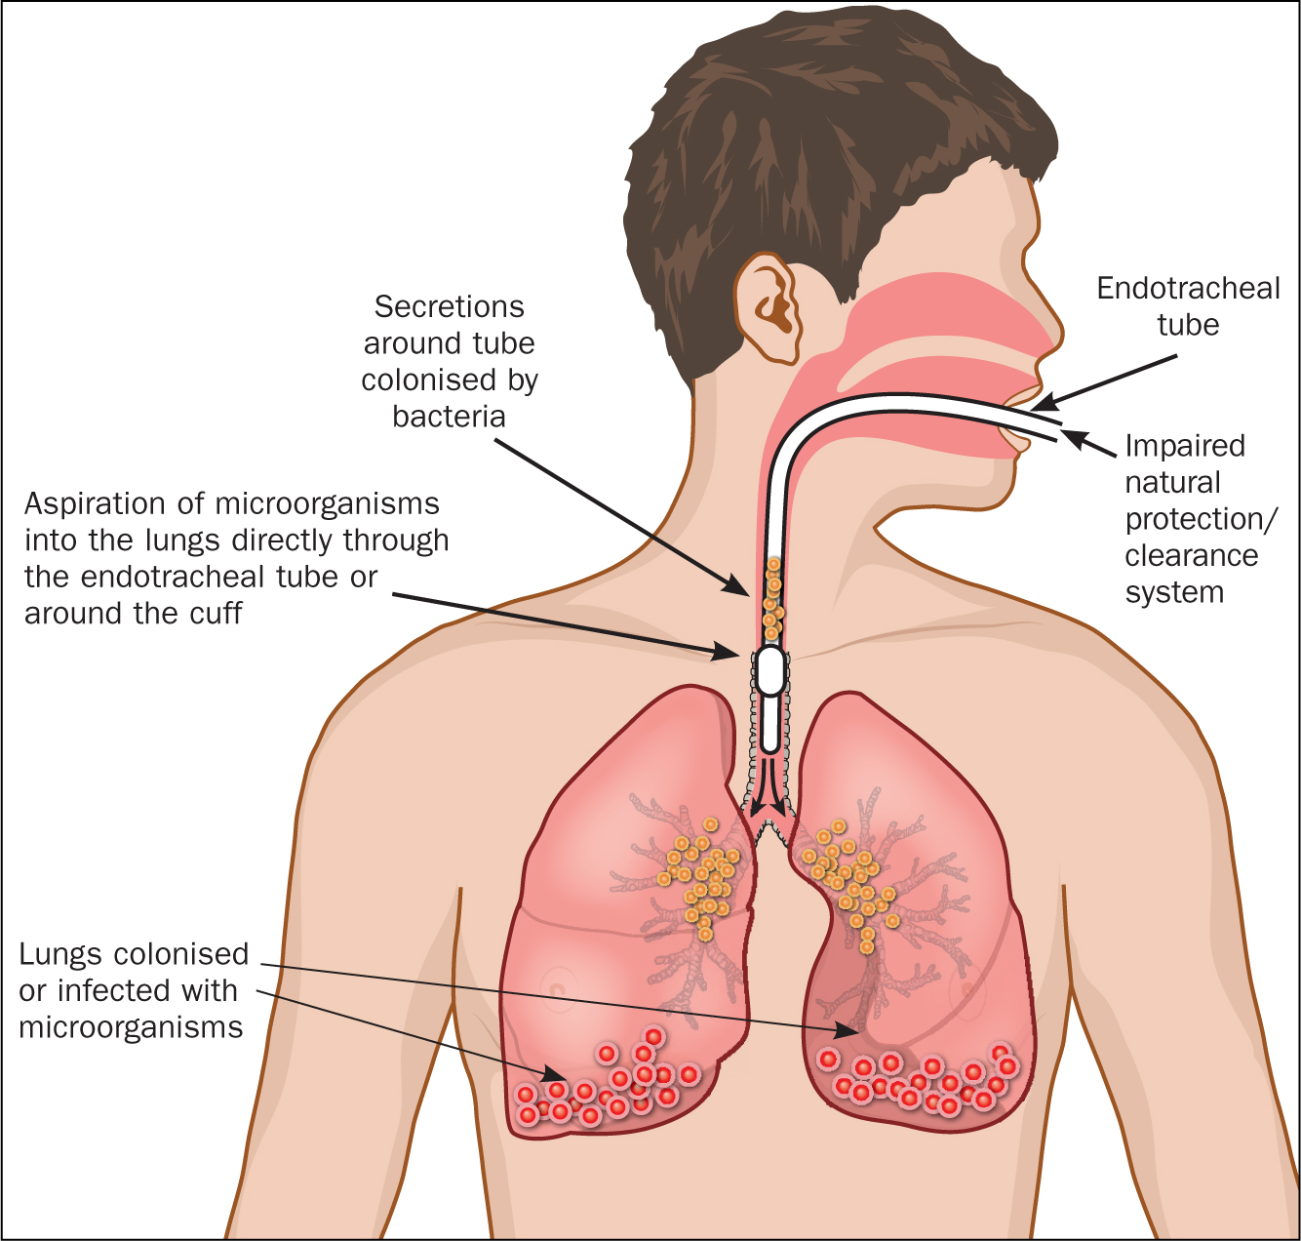
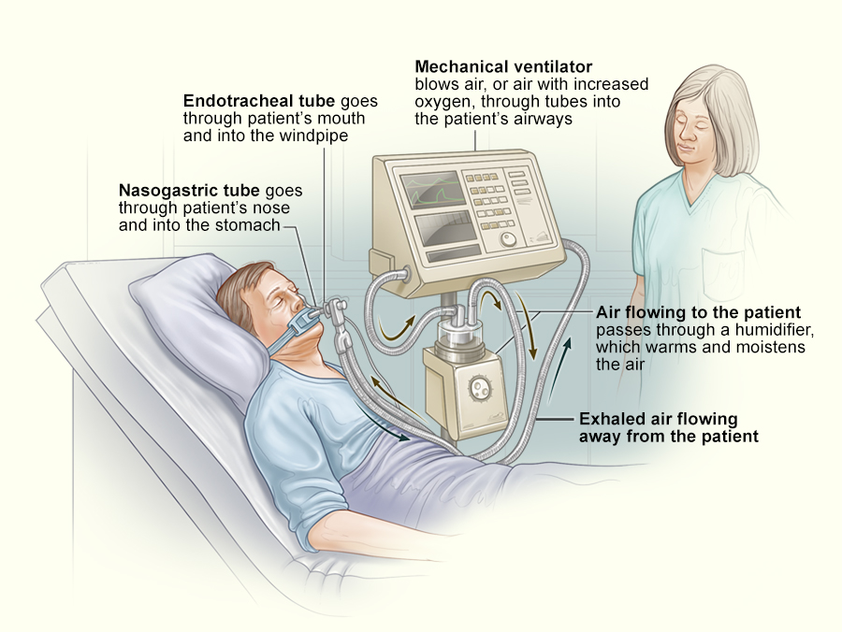
Effectiveness of Oral Chlorhexidine in Prevention of Ventilated Associated Pneumonia Harrison Scalise, SN DHCON Faculty Mentor: Dr Theresa Soltis, DNP, APRN, FNP-BC Sacred Heart University, Davis and Henley College of Nursing - Fairfield, CT Thomas More Honors program
Purpose
Findings
Clinical Implications
The purpose of this research is to test the most effective form of oral hygiene to help prevent against ventilator associated pneumonia.
Potassium Permanganate and Chlorhexidine were the two solutions tested against each other and their results were compared to conclude which had lower incidence rates of Ventilator-Associated-Pneumonia.
Research showed that only 28 of the 150 patients were diagnosed with a case of VAP which is 18.7%. Of that 28, 15 patients were in the control group, 6 patients were in the chlorhexidine group, and 7 were in the potassium permanganate group showing how oral care provided with chlorhexidine had the lowest number of instances. Furthermore, there were 16 patients who had the unfortunate ending of passing away. Of the patients that passed, 5 were in the control group, 4 were in the chlorhexidine group, and 7 were in the potassium permanganate group. Again, showing that chlorhexidine worked best at combating VAP.
It has been found that incorporation of routine oral hygiene may reduce VAP by as much as 60% (Gupta et al., 2016).
VAP is one of the most common forms of infection found in ICU patients who are intubated. A study found that more than 90% of cases of ICU-related pneumonia occurred during mechanical ventilation, and nearly 50% of these cases occurred during the first 4 days of mechanical ventilation (Fu, 2023).
Background
Hospital-acquired infections (HAI’s) are one of the most contributing factors of mortality and morbidity. According to data about 10% of bedridden cases in developed countries and 25% in developing countries lead to HAI’s (Meidani, 2018). Hospital- acquired pneumonia, especially VAP, is the leading cause of death in ICU, with mortality rate from 24% to 76% (Meidani, 2018). One of these HAI’s that is being so heavily looked at today is known as ventilator associated pneumonia or VAP. Ventilator-associated pneumonia (VAP) refers to the development of pneumonia in patients with mechanical ventilation occurring at least 48 hours after admission (Fu, 2023).
Implications to Nursing Practice
References
Nurses should be provided education on the topic of ventilatory associated pneumonia and how to prevent it through the use of oral hygiene with chlorhexidine solution.
Notes:
de Lacerda Vidal, C., de Lacerda Vidal, A., de Moura Monteiro, J., Cavalcanti, A., Henriques, A., Oliveira, M., Godoy, M.,
Coutinho, M., Sobral, P., Vilela, C., Gomes, B., Leandro, M., Montarroyos, U., de Alencar Ximenes, R., & Lacerda, H.
(2017). Impact of oral hygiene involving toothbrushing versus chlorhexidine in the prevention of ventilator-associated
pneumonia: a randomized study. BMC Infectious Diseases, 17(1), 112. https://doi.org/10.1186/s12879-017-2188-0
Fujimoto, H., Yamaguchi, O., Hayami, H., Shimosaka, M., Tsuboi, S., Sato, M., Takebayashi, S., Morita, S., Saito, M., Goto, T., & Kurahashi, K. (2018). Efficacy of continuous versus intermittent subglottic secretion drainage in preventing ventilator-associated pneumonia in patients requiring mechanical ventilation: A single-center randomized controlled trial. Oncotarget, 9(22), 15876–15882. https://doi.org/10.18632/oncotarget.24630
Gruner, C., Kutluturkan, S. (2021). Role of head-of-bed elevation in preventing ventilator associated pneumonia bed elevation and pneumonia. Nursing in Critical Care. Liu, W., Yang, Y., Jiao, Y., Zhang, K., Hai, Y., Li, H., Xing, H., Xu, B., Bai, H., Zhao, Y., Bao, H., Zhang, S., Ren, W., Yang, L., Yang, H., Tian, J., Wang, M., & Guo, T. (2020). Evaluation of the effects of applying the ventricular care bundle (VCB) method for reducing ventilator-associated pneumonia (VAP) in the intensive care unit of a general Chinese Tertiary Hospital. Annals of Palliative Medicine, 9(5), 2853–2861. https://doi.org/10.21037/apm-20-289
Maertens, B. , Lin, F. , Chen, Y. , Rello, J. , Lathyris, D. & Blot, S. (2022). Effectiveness of Continuous Cuff Pressure Control in
Preventing Ventilator-Associated Pneumonia: A Systematic Review and Meta-Analysis of Randomized Controlled Trials*. Critical Care Medicine, 50 (10), 1430-1439. https://doi.org/10.1097/CCM.0000000000005630
Sousa, A. S., Paiva, J. A., & Ferrito, C. (2019, February 26). Application of a ventilator associated pneumonia prevention guideline and outcomes: A quasi-experimental study. Intensive & critical care nursing. Retrieved November 5, 2022, from https://pubmed.ncbi.nlm.nih.gov/30366645/
Wen, Z., Zhang, H., Ding, J., Wang, Z., & Shen, M. (2017). Continuous versus intermittent subglottic secretion drainage to prevent ventilator-associated pneumonia: A systematic review. Critical Care Nurse, 37(5), e10–e17. https://doi.org/10.4037/ccn2017940

