Slide 1
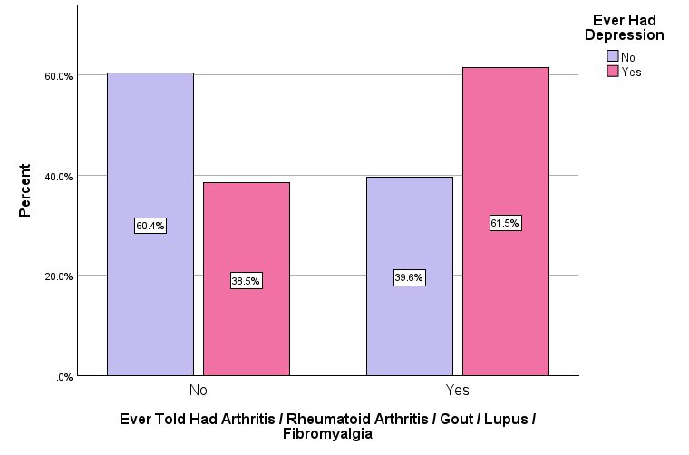
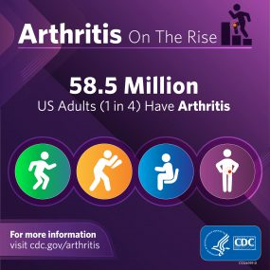
The Relationship Between Arthritis and Depression in Adults 55 to 85 Years Old
Marissa Heinz, Emily Marshall, Emily Wightman, Brooke Yencha [Faculty Mentor: Dr. Rui Liu]
College of Health Professions, Sacred Heart University
Background
Participant Characteristics | Frequency (%)
Age (Mean, SD) | 68.8 (8.9)
Gender
Female | 7911 (56.3%)
Male | 6133 (43.7%)
Race/Ethnicity
Hispanic | 1157 (8.2%)
Non-Hispanic White | 10707 (76.2%)
Non-Hispanic Asian | 1430 (10.2%)
Non-Hispanic American Indian / Alaskan Native | 564 (4.0%)
Other | 186 (1.3%)
Provider-Diagnosed Arthritis
Yes | 6094 (43.4%)
No | 7950 (56.6%)
Self-Diagnosed Depression
Yes | 2438 (17.4%)
No | 11606 (82.6%)
Table 1. Descriptive Statistics: Participant Characteristics (N=14,044)
Results
Conclusions
1 in 5 U.S. adults have doctor-diagnosed arthritis (Fallon et al., 2023).
1 in 5 U.S. adults with arthritis also suffer from symptoms of depression (CDC, 2021).
Patient-reported anxiety and depression is associated with poorer health outcomes (Peterson et al., 2019).
Roughly 61.5% of participants with physician-diagnosed arthritis reported ever experiencing depression, compared to 39.6% that did not experience depression.
On the contrary, only 38.5% of participants without physician-diagnosed arthritis had self-reported depression.
The Chi-square analysis p-value was p<0.001.
The p-value is less than 0.05, indicating that there is a statistically significant association between physician-diagnosed arthritis and self-report depression.
There is a statistically significant relevant association between arthritis diagnoses and experiencing depression.
Found through background research, the relationship between the two variables is bidirectional.
Providers should treat patients for arthritis while acknowledging and screening for possible depressive symptoms.
Further research should include studies on genetic predispositions to both conditions.
A future implication includes analyzing participants and treatment methods for both conditions long term to test for level improvements.
Objectives
To identify and analyze the relationship between arthritis and depression.
Hypothesis: Having a diagnosis of arthritis in adults 55 to 85 years old is related to a higher prevalence of self-reported depression.
Methods
Observational secondary analysis using cross-sectional data from the 2021 National Health Interview Study.
Participants:
14,044 United States citizens, ages 55-85
Both male (43.7%) and female (56.3%)
Participants of different ethnic backgrounds
Exposure Variable: Physician-diagnosed Arthritis
Outcome Variable: Self-reported Depression
A bivariant Chi-square test was generated to determine the association between the exposure and outcome.
Figure 2. Arthritis Infographics (CDC, 2024)
References
Centers for Disease Control and Prevention. (2024, February 22). Arthritis infographics. Centers for Disease Control and Prevention. https://www.cdc.gov/arthritis/communications/infographics/index.html ​
Centers for Disease Control and Prevention. (2021, May 7). The Arthritis-Mental Health Connection. Centers for Disease Control and Prevention.https://www.cdc.gov/arthritis/communications/features/arthritis-mental-health.htm#:~:text=About%201%20in%205%20US​
Fallon, E. A., Boring, M. A., Foster, A. L., Stowe, E. W., Lites, T. D., Odom, E. L., & Seth, P. (2023). Prevalence of Diagnosed Arthritis - United States, 2019-2021. MMWR. Morbidity and mortality weekly report, 72(41), 1101–1107. https://doi.org/10.15585/mmwr.mm7241a1​
Peterson, S., Piercy, J., Blackburn, S., Sullivan, E., Karyekar, C., & Li, N. (2019). The multifaceted impact of anxiety and depression on patients with rheumatoid arthritis. BMC Rheumatology, 3(1), 1–10. https://doi-org.sacredheart.idm.oclc.org/10.1186/s41927-019-0092-5
Figure 1. Association Between Provider-Diagnosed Arthritis and Self-Reported Depression

