Slide 1
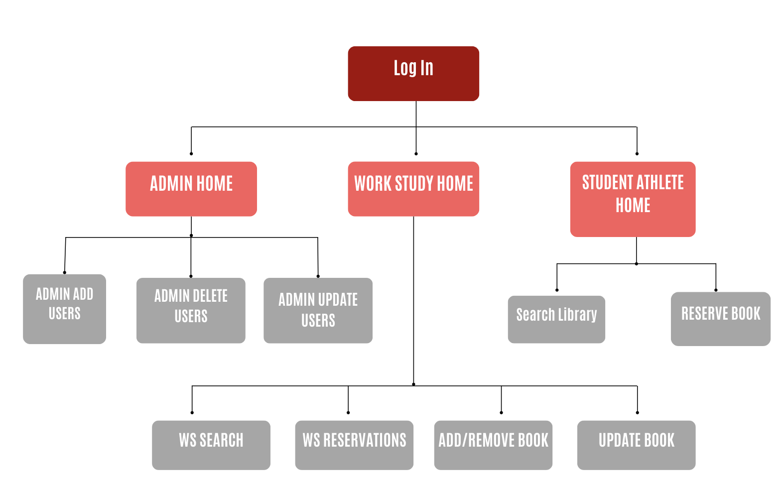
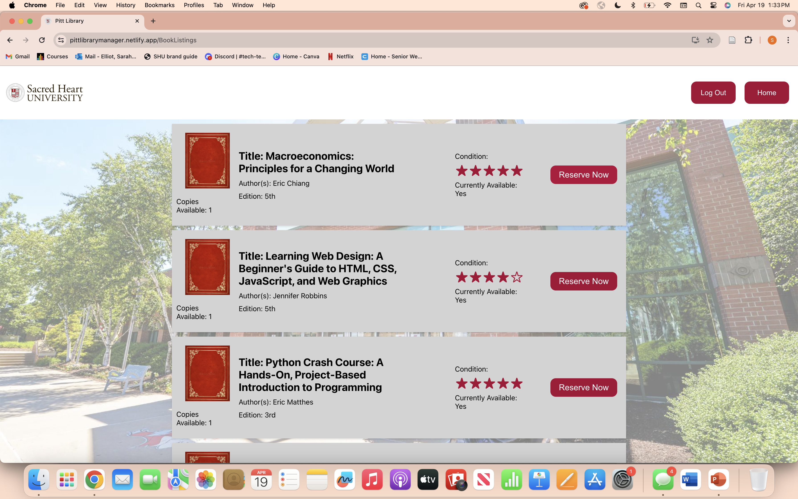
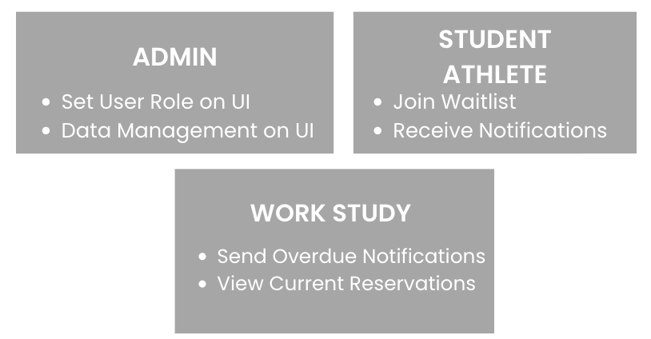
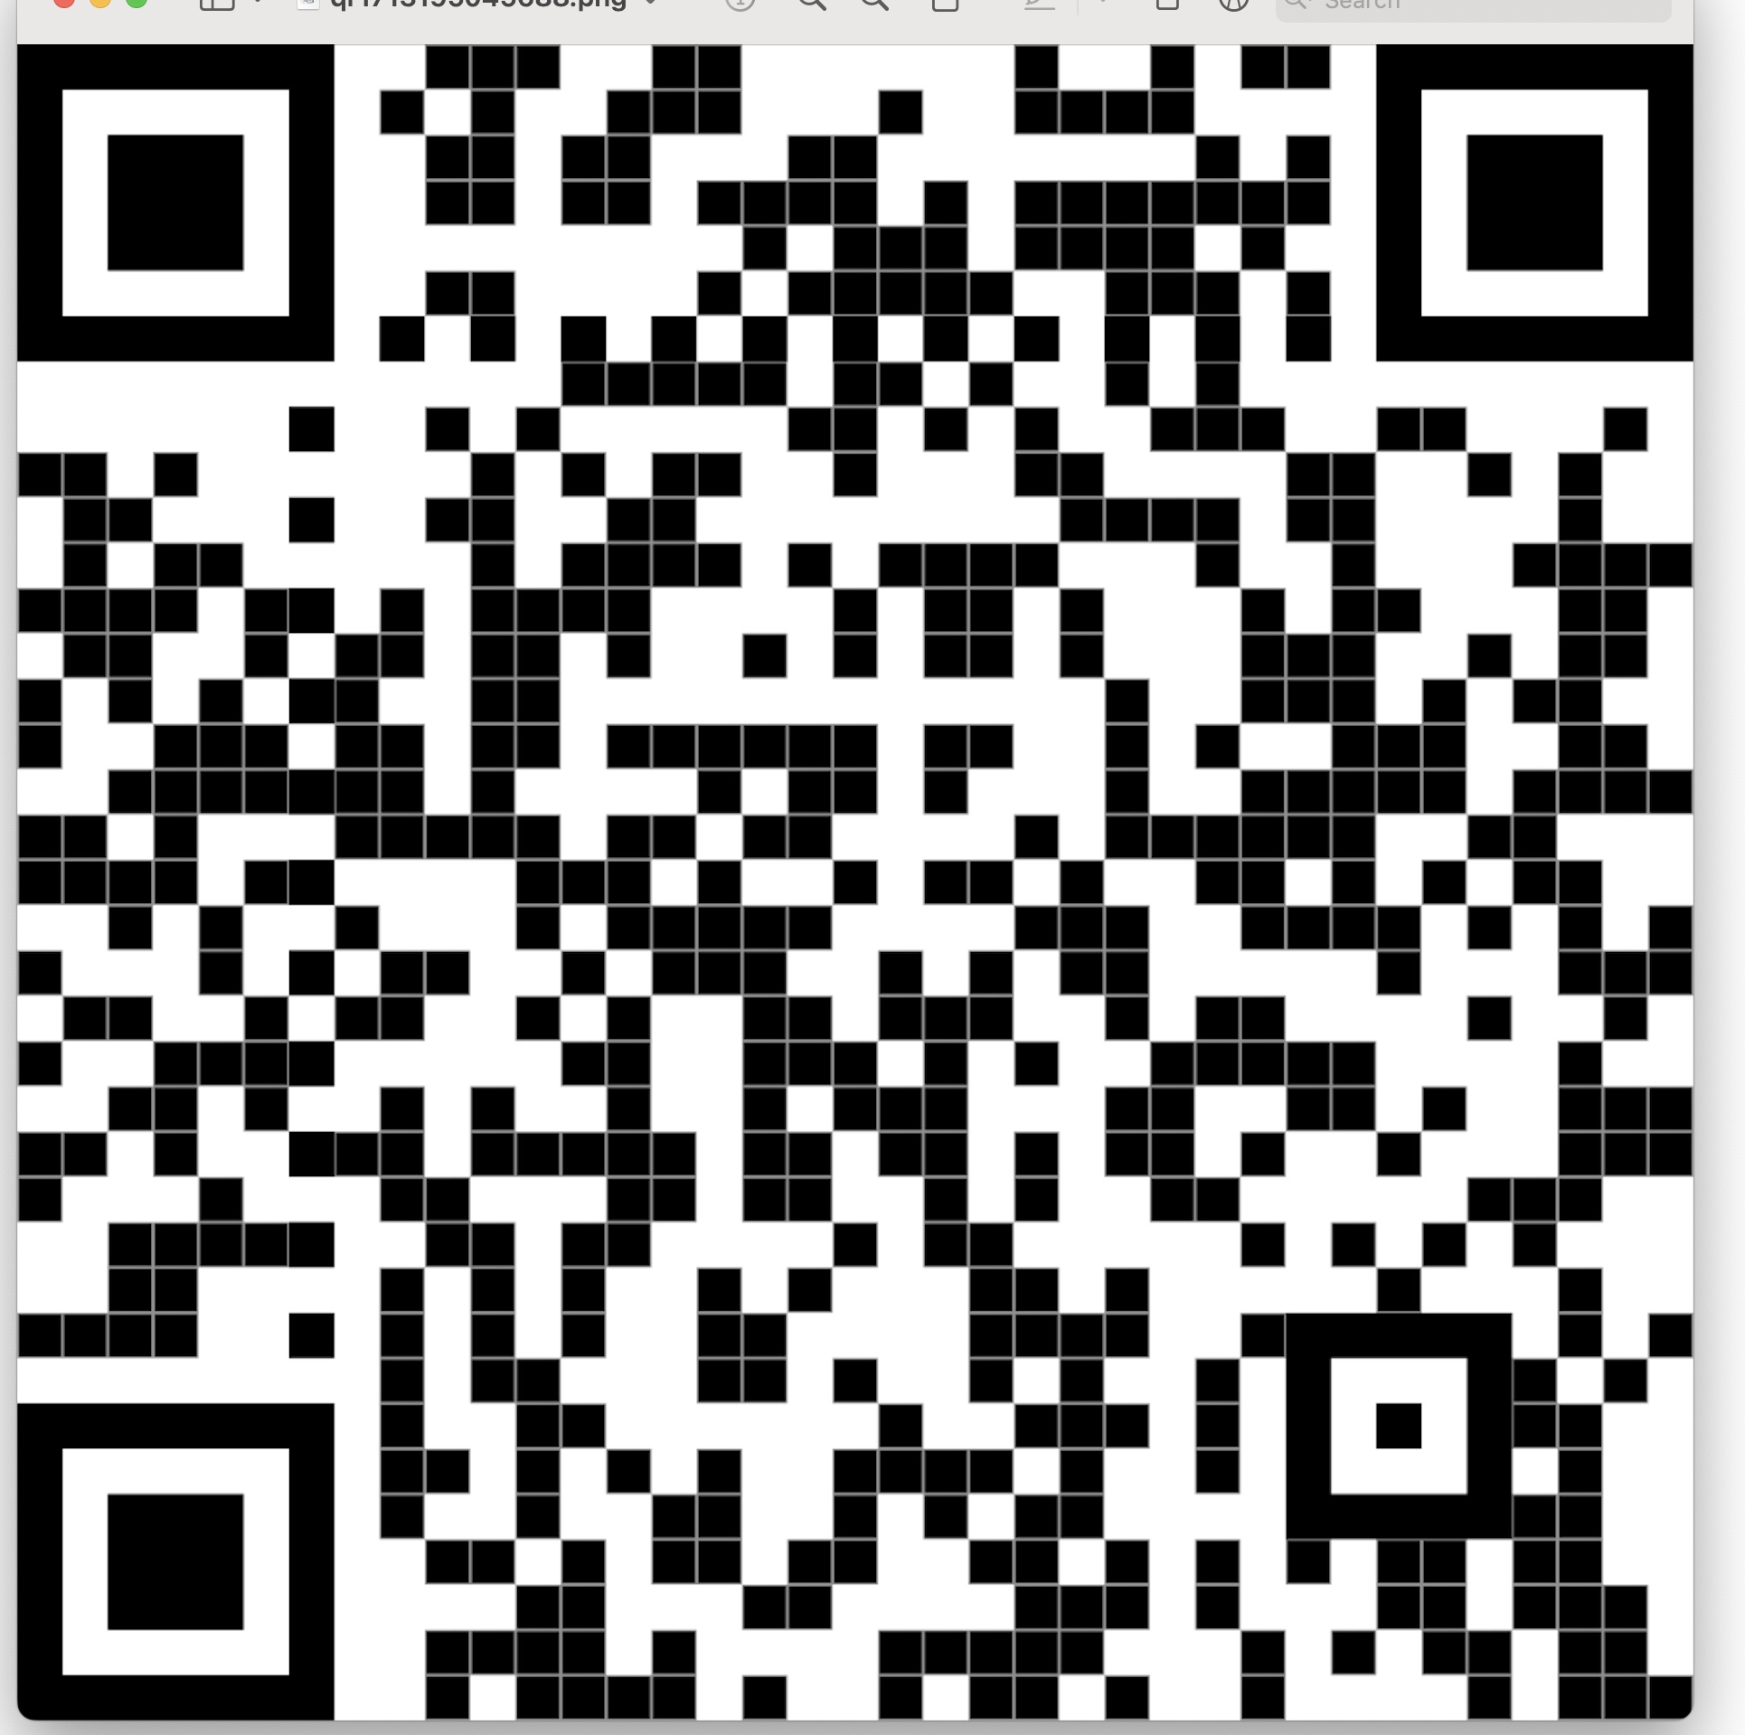
Pitt Library Manager
Sarah Elliot, Computer Science ; Owen Geis, Game Design/IT;
Danielle Leblanc, Cybersecurity/Computer Science
Abstract
Flow Chart
Tech Stack
The Student-Athlete Success Center for D1 athletes at Sacred Heart University maintains a library for student-athletes to check out textbooks for free, making it easier for them to obtain course materials. Currently, the Pitt Library is managed through a paper-based system, resulting in a multitude of complications such as inaccurate tracking and missing inventory. The work-study platform will allow those working at the library to add and remove books, check books in and out of the library, and monitor and update the condition of the books. The student-athlete portion of the application allows student-athletes to virtually search the library for books and reserve individual books. All users of the system will be able to log in with their SHU credentials, bringing them to the necessary page to complete their desired task. These features, along with more diligent management of the physical library, will help remedy the current problems observed by the staff of the Student-Athlete Success Center.
Future Features

