Slide 1
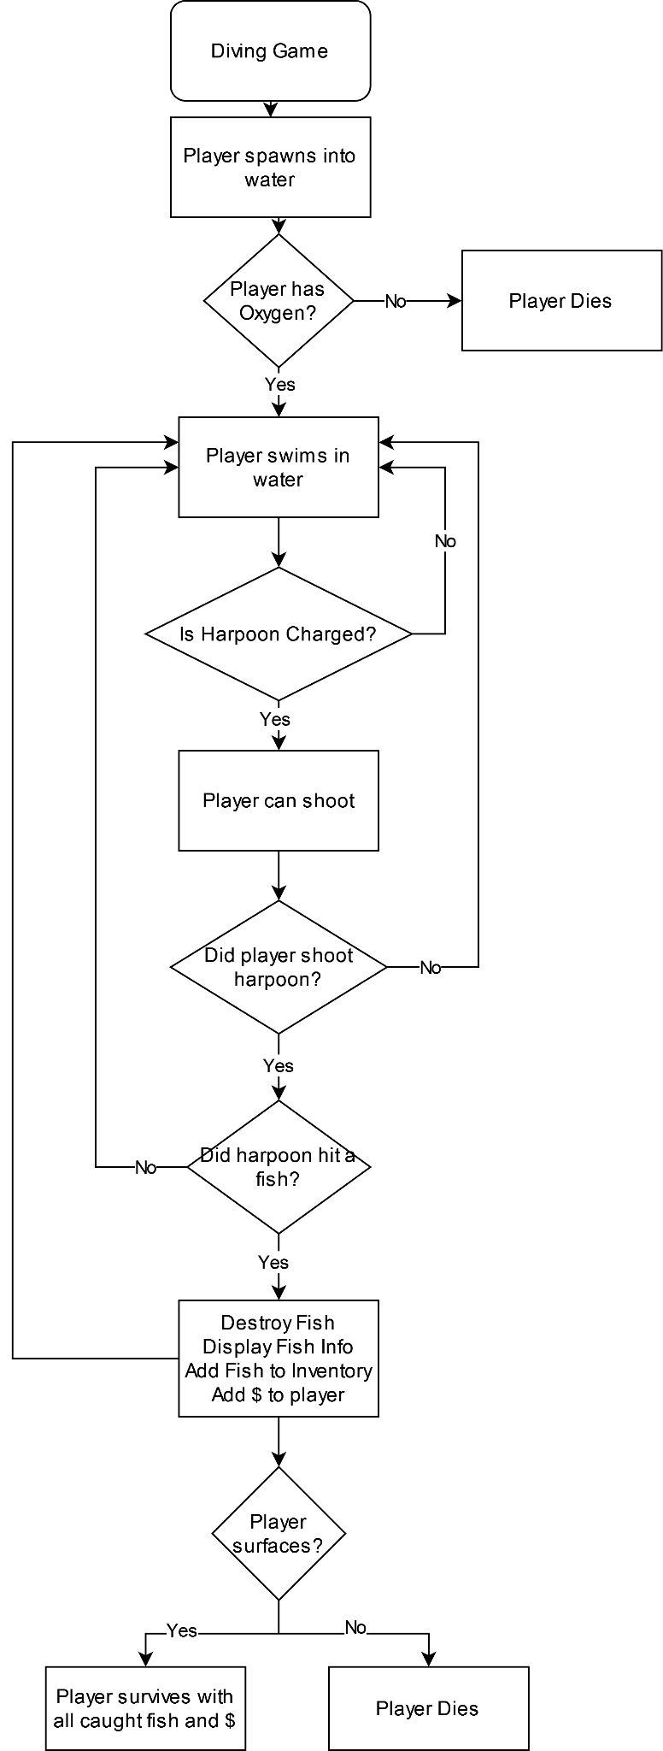
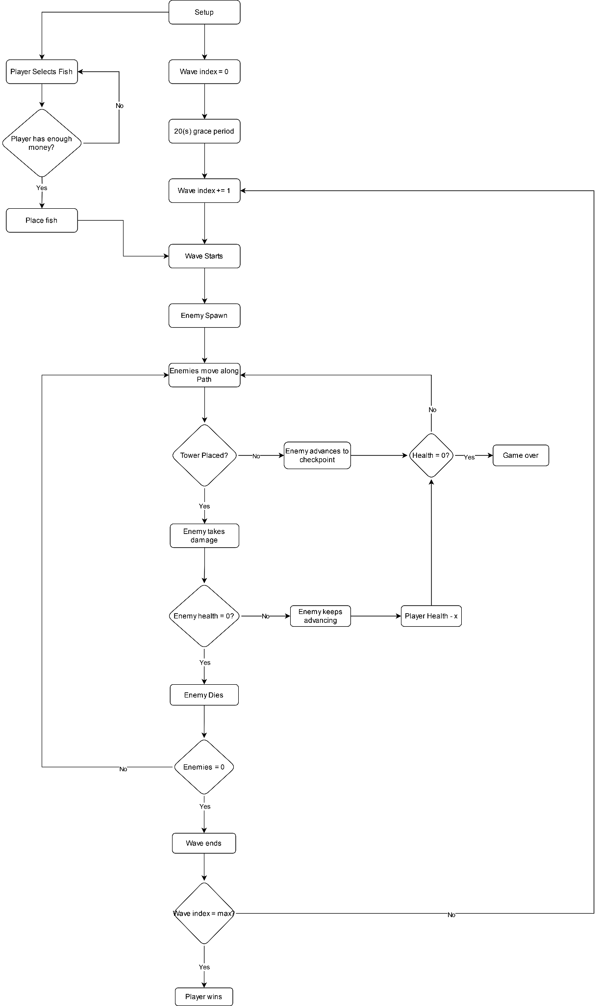
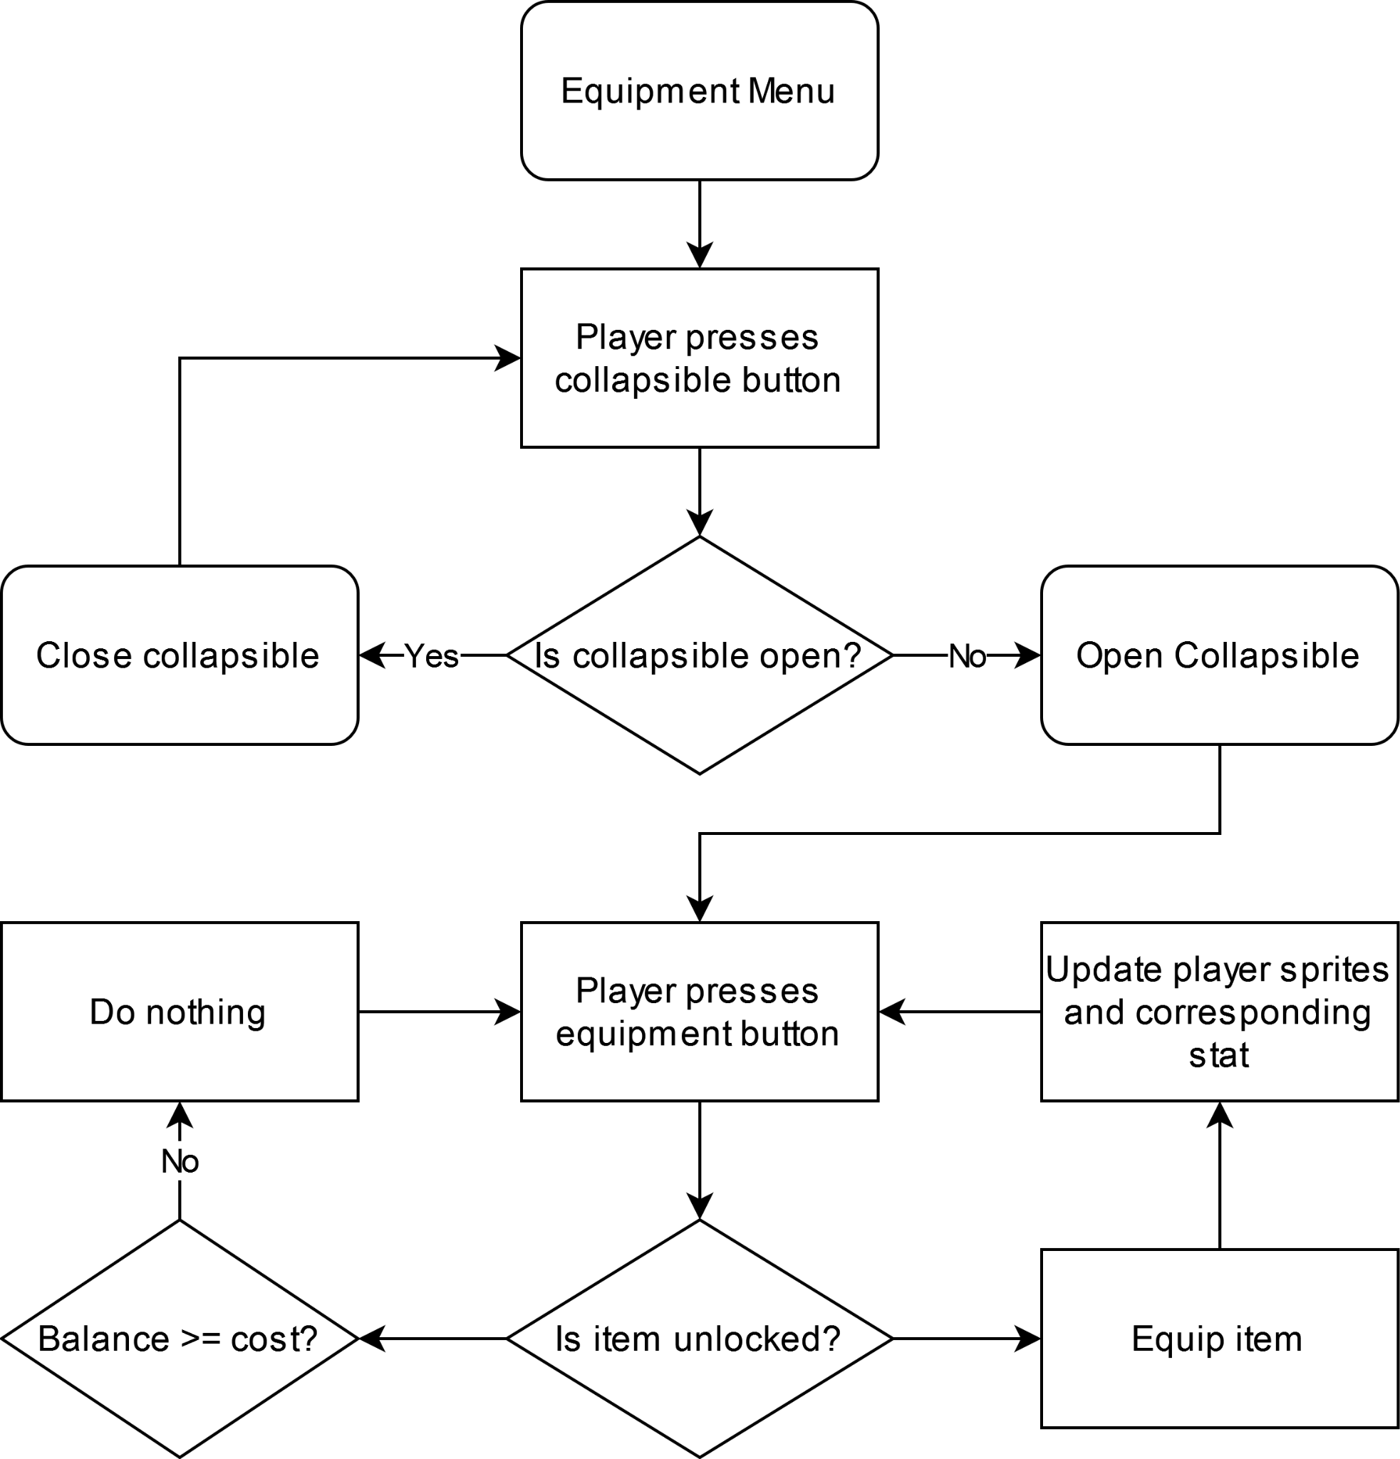
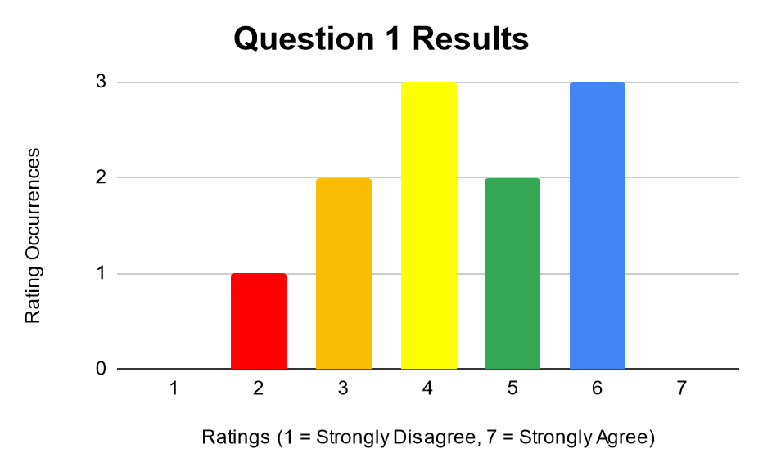
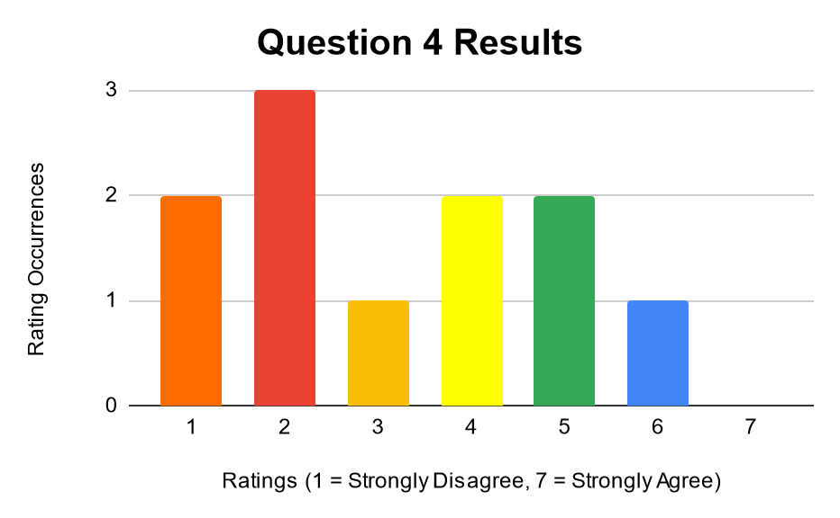
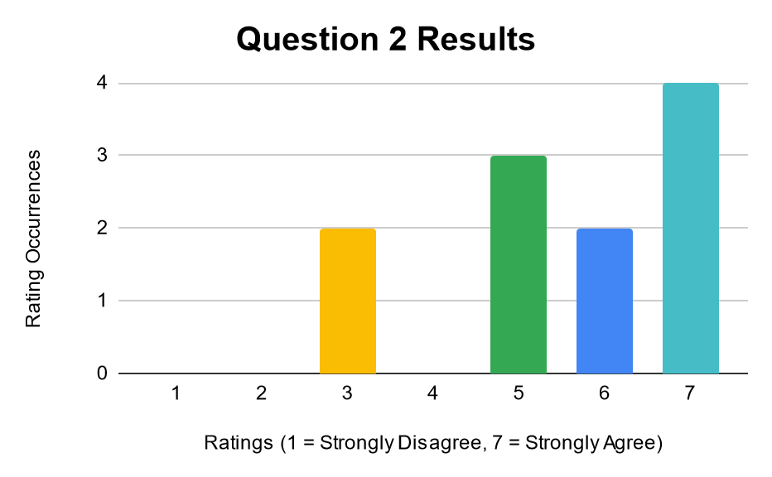
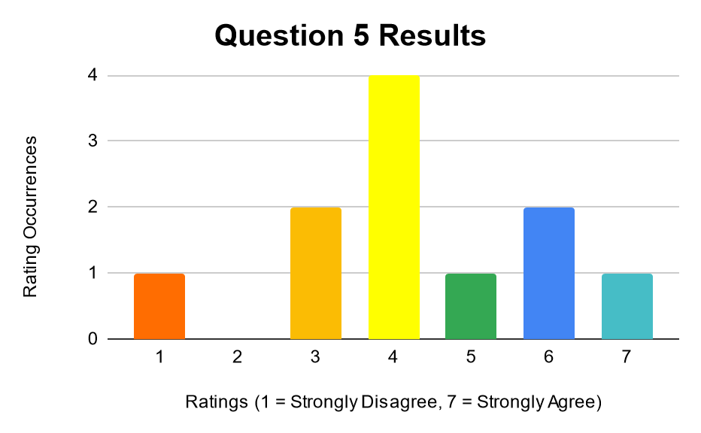
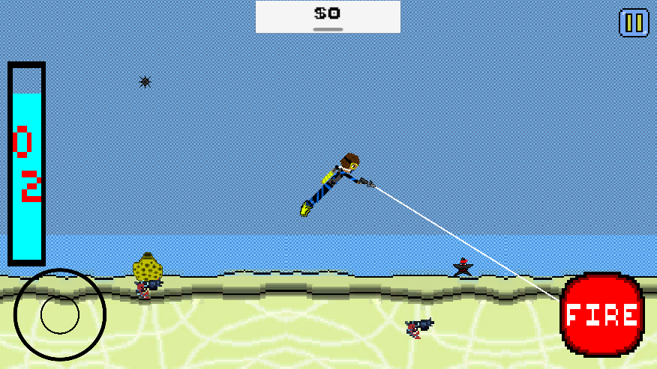
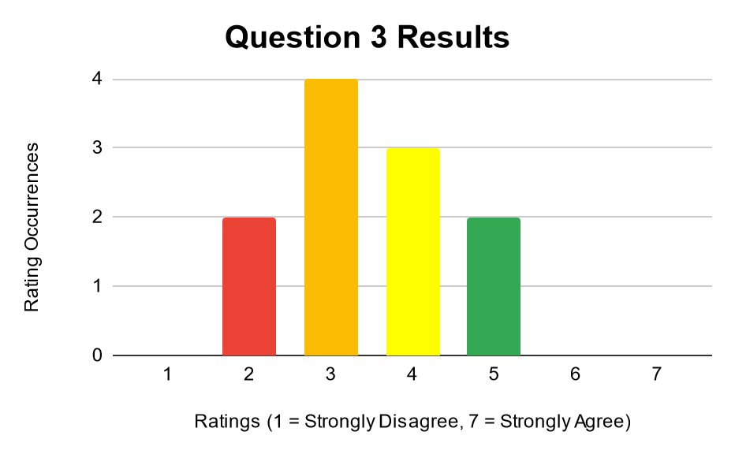
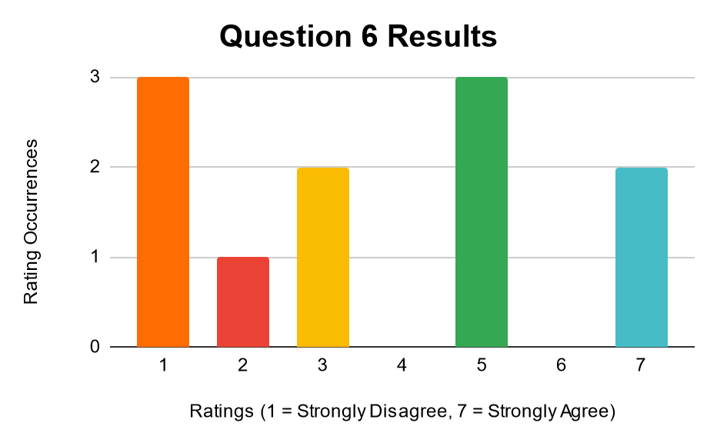
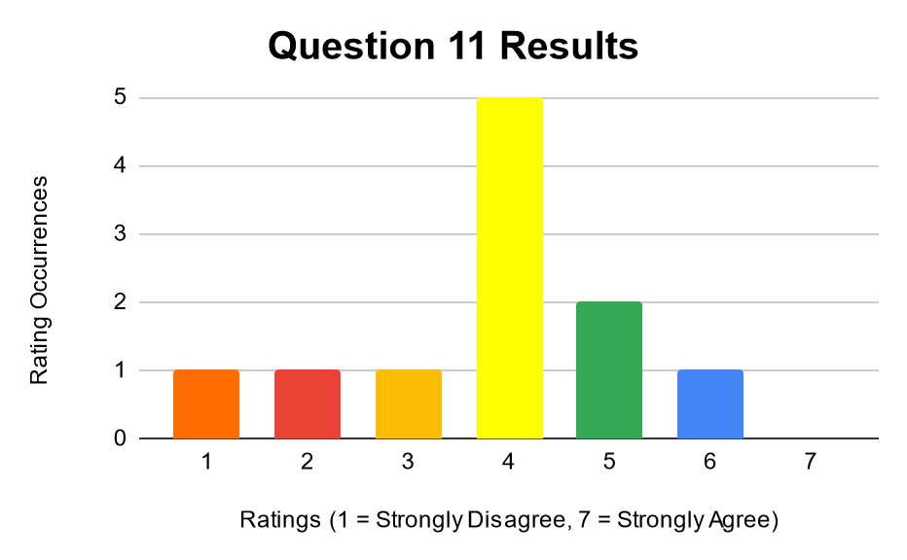
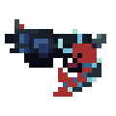
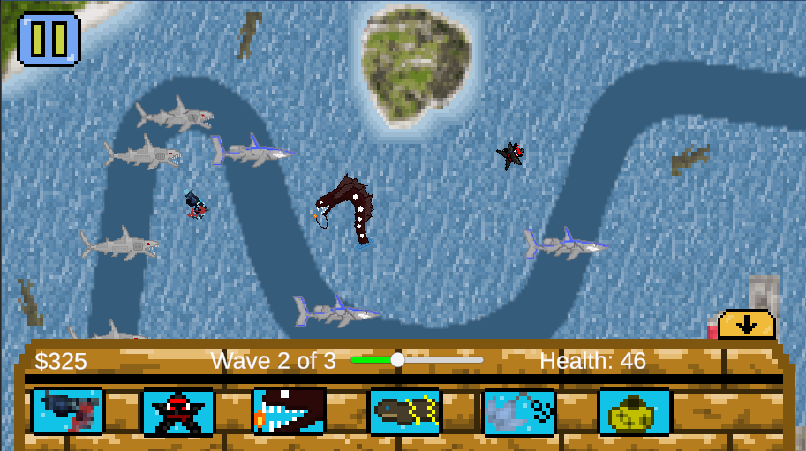
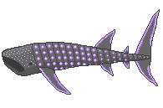
Interaquatic Assault
Bryce Becker, Michael Tenam, Owen Geis, Devin O’Connell, Ryan Riccio, David Robillard, Niko Cappiello, Seth Silvestro, Justin Bebarski, Jamie Carvajal Perez, and Jordan Tewell
INTRODUCTION
PROGRAMMING
ALPHA TEST
Interaquatic Assault is an action-adventure, tower defense, and strategy game for iPad and Android tablets developed by Sacred Heart University’s Game Design and Development Senior undergraduate students. The objective of the game is to capture fish and use them to defend the player’s base against enemy robot sharks called Megabites. The game aims to be a fun experience for people interested in sci-fi, diving, space, and tower defense games.
The first part of the game is the diving phase where the player collects as many fish and marine animals as they can before their oxygen runs out. Fish can be exchanged for money which is used in the defense phase to create towers. Players control the diver using the analog control stick in the bottom left corner of the screen and use the fire button to shoot their harpoon out to collect fish, which is indicated by a white line. Different fish will yield different monetary rewards, with more expensive fish lurking near the seabed. Players must then resurface to complete this part of the game, or else run out of oxygen.
Diving
The player spawns and can swim around in search of fish to harpoon and put in their inventory. The player’s oxygen level begins to decrease when they spawn, so the player must be cautious and make sure they surface before running out. If the player has oxygen, they can swim around freely in the water in search of fish to harpoon.
When the player shoots their harpoon, a cooldown will start and prevent them from shooting until the cooldown ends. When fired, if the harpoon hits a fish, that fish will be destroyed, a collision sound will play, and all necessary fish info will be passed into the inventory and the respected currency amount is added to the player’s currency. If the harpoon does not collide with a fish, the harpoon will destroy itself after a set time. If the player surfaces while they still have oxygen left, the player survives with all caught fish and currency, whereas if the player runs out of oxygen, they die and lose all of their caught fish and currency from the dive.
Tower Defense
Starts with a 20 second grace period where the player can place fish/towers if they have the money. Once the 20 seconds are up, the 1st wave starts. Enemies move on a path.
Equipment
Our game was playtested in its Alpha state, and testers took a survey that consisted of seven questions where testers rated both the diving and defense parts of the game from 1(Strongly Disagree) to 7(Strongly Agree), as well as qualitative questions on what they liked and what could be improved.
I enjoyed the diving/tower defense phase:
Diving Phase
The player is able to upgrade their abilities in the diving section through the equipment shop by spending gems. There are four slots in the shop: the harpoon gun, the scuba tank, the flippers, and the suit. The harpoon gun increases harpoon damage, the flippers increase movement speed, and the scuba tank increases the player's maximum oxygen (and thus maximum dive time). The suit has no gameplay benefit, and is only useful for customization. There are three tiers of each item: Tier 1, which is unlocked by default, Tier 2, which costs 200 gems to unlock, and Tier 3, which costs 300 gems to unlock.
Diving/tower defense phase controls were easy to understand:
If the enemy is within the tower’s range, the enemy will receive damage and be destroyed.
I found the diving/tower defense phase difficult:
If the enemy makes it to the end, the player loses health. If the player runs out of health, then they lose and must restart. If all enemies are gone, then the next wave starts. Once all waves end, the player wins.
ART & DESIGN
I had fun:
Tower Defense Phase
The art application that was utilized was Piskel. With this, the artists were able to create characters, backgrounds, projectiles, and animations for the game. The art style is a 16-bit, retro game which provides vibrant colors, smooth animations, and imaginary environments. The artists were able to create detailed and immersive artwork that helps players feel more connected to the game world, allowing them to fully engage with the gameplay experience.
In the tower defense phase, the player must defeat all the incoming Megabite sharks who will attack the player’s base. To stop them, the player must buy towers with the money they earned from collecting fish from the diving phase. Towers can then be placed around the level by dragging them into position. As the level progresses, the player upgrades the towers so they defeat enemy waves quicker.
Enjoyment of the diving phase was mixed, though testers found the controls easy to understand and the difficulty was balanced. Testers remarked that the amount of fish and their statistics including speed should be adjusted, as well as the addition of a depth meter, fixing the background to increase sense of movement, and to fill in the level more with objects and fish. Testers also felt aiming should be more seamless, smoother and easier to understand.
Enjoyment of the tower defense phase was also mixed, but testers felt the controls were understandable. There was a lot of variance in the perceived difficulty. Testers remarked that enemy statistics like health and speed needed adjustment, as well as the money awarded and the tower ranges so they are not too overpowered. They also wanted a timer added.
The Pistol Shrimp shoots at a moderate fire rate and damage.
The Ninja Starfish starts shooting at a high rate of fire but low damage.
The Flingray carries a heavy anchor thrown at enemies that enter its short range, doing high damage.
The Dragonfish spews flames hitting multiple enemies.
Orion is the main character and is a harpoon fisherman.
Overlord Shiver is the main villain who wants to defeat the Shoaling Army.
The Hammerhead Shark has a speed of 2 and 40 hp statistics
The Mako Shark is the quickest and has a speed of 6 and 10 hp statistics.
The Whale Shark, once defeated spawns a nurse, two hammerheads, and two makos where it dies.
Play our game!
https://chaotixgamer.itch.io/interaquatic-assault
The Basic Shark has 15 hp and 3 speed statistics.

