Slide 1

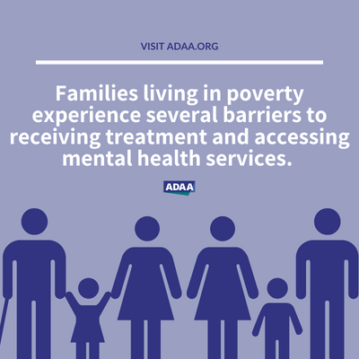
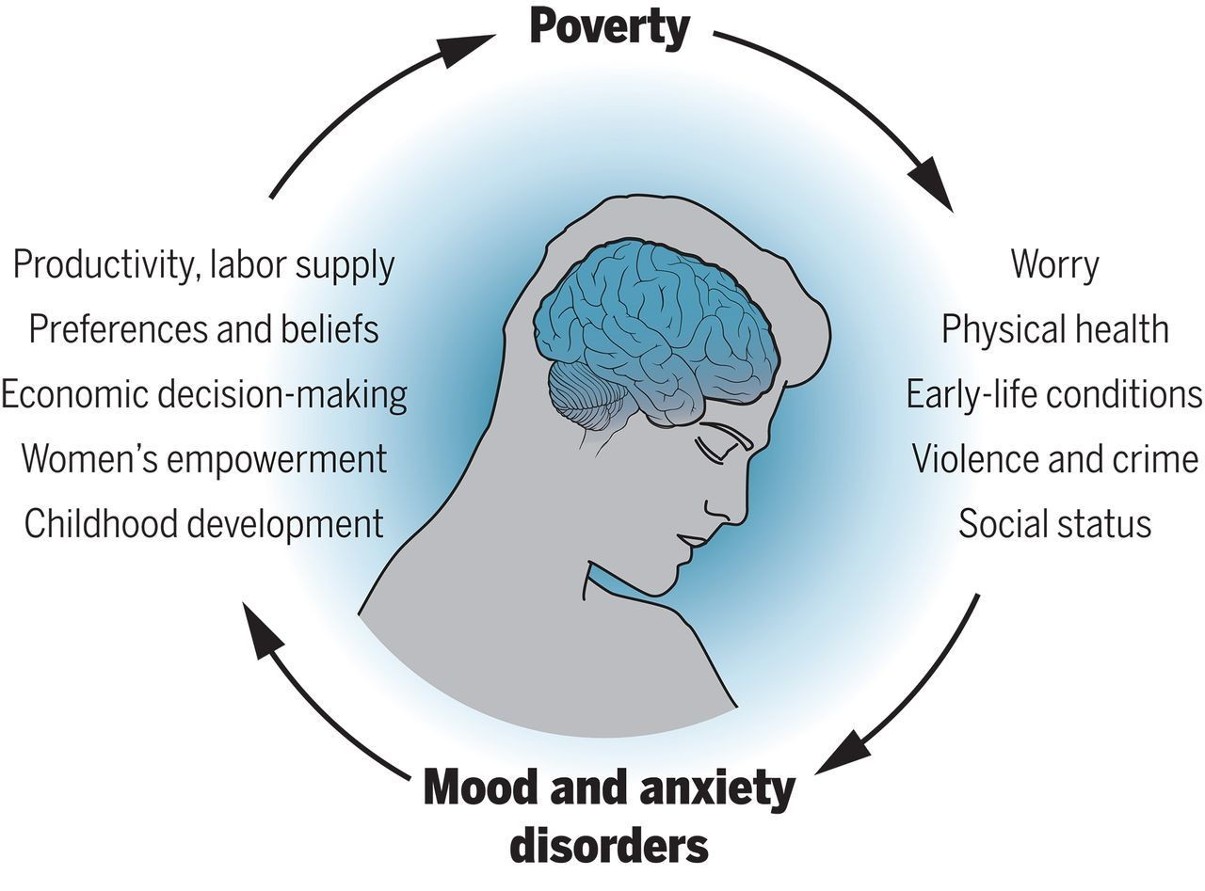
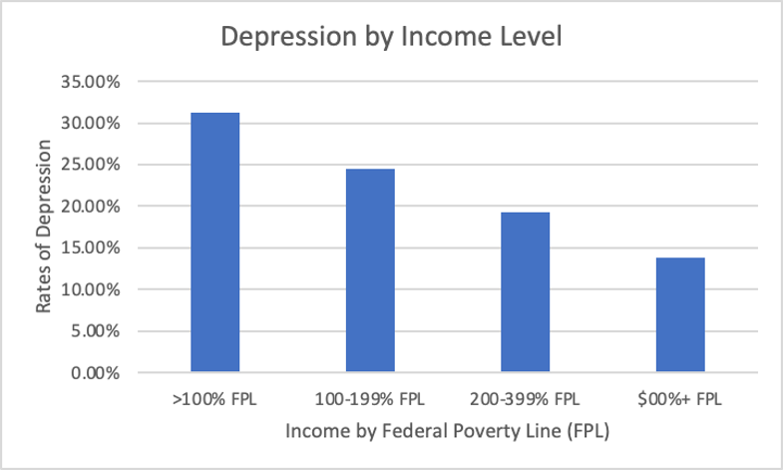
How Poverty Affects Depression in Adults 25-65
Stephanie Capito, Jillian Spindel, and Claudia Uva
Department of Health Sciences, Sacred Heart University
Introduction
Objectives
Results
Depression is negatively correlated with income level.
This can be interpreted as those who live in poverty have a higher level of depression.
Major depression is one of the most common mental disorders in the United States (National Institute of Mental Health, 2020).
  Depression can interfere with or limit one's ability to perform life activities (NIMH, 2020).
  In 2020, 18.4% of US adults reported having been diagnosed with depression (CDC, 2020).
  Income is a broad term that can be defined as:
  The money an individual makes (Scott, 2023).
  Total earnings in the form of wages or salaries (Scott, 2023).
  A low income can come with disadvantages such as unstable living conditions, eviction, inability to afford healthy foods, and poor mental health conditions (Scott, 2023).
  In 2023, the poverty threshold for a single individual was $14,580 (Federal Poverty Line).
  Recent literature supports the findings that depression and low income in adults aged 25-65 are correlated.
To explore the relationship between poverty level and depression in adults ages 25-65.
Descriptive Statistics
  The frequency of those depressed at least monthly was 18.7% (N= 3,464)
  The frequency of those exposed to poverty was dependent upon the family poverty line:
  9.9% of the sample lived below the poverty line.
Hypothesis
Conclusions
Poverty level and depression are significantly associated in adults ages 25-65.
Based on our analysis, the answer to our research question is yes.
Income level is significantly associated with depression among young adults ages 25-65.
The literature reveals a strong link between our hypothesis and what was found.
Persons with low family savings had 1.49 times higher odds (95% confidence interval, 1.01–2.21) of having depressive symptoms than persons with high family savings” (Ettman et al., 2020).
For future research, we recommend narrowing down the age group so the results can be more marginalized toward middle-aged families struggling with poverty.
A strength of our research is that we used a nationally representative data set.
A limitation of this research is that it was an observational secondary data analysis.
Poverty and Depression in Adults Between the Ages of 25 and 65 Amongst a Population of 18,525
Variable | Frequency or mean
DEPRESSION | Depressed at least monthly: Yes: 18.7% No: 81.3%
POVERTY | Less than 100% FPL: 9.9% 100% to less than 200% FPL: 15.3% 200% to less than 400 % FPL: 27.4% 400 % and greater FPL: 47.4%
Age (Mean) | 45.84
Gender (%male/female) | M:46.2%, F:53.8%
Race/Ethnicity (%in each category) | White: 63.8% Black: 11.4% Hispanic: 15.9% Asian: 7.4% American Indian/ native: 1.5%
Figure 2: Exhibits how poverty leads to barriers regarding mental health services (Low-Income Communities | Anxiety and Depression Association of America, ADAA, n.d.).
Methods
References
Observational secondary data analysis
Cross-sectional data from the National Health Interview Survey for Adults from 2021.
Participants
Total sample size: N = 18,525
Adults ages 25-65 in the United States
46.2% male and 53.8% female
Variation of races
  White – 63.8%
  Black – 11.4%
  Hispanic – 15.9%
  Asian – 7.4%
  American Indian/Native – 1.5%
Measures
Depressed at least monthly – outcome
Federal Poverty Line - exposure
Table 1: Poverty and Depression in Adults Between the Ages of 25 and 65 Amongst a Population of (N=18,525).
Centers for Disease Control and Prevention. (2023). National, state
-level, and county-level prevalence estimates of adults aged ≥18
years self-reporting a lifetime diagnosis of Depression - United
States, 2020. Centers for Disease Control and Prevention.
Ettman, C. K., Cohen, G. H., & Galea, S. (2020). Is wealth associated with
depressive symptoms in the United States? Annals of Epidemiology,
43, 25. https://doi.org/10.1016/j.annepidem.2020.02.001
Low-income communities: Anxiety and Depression Association of
America, ADAA. Communities | Anxiety and Depression
Association of America, ADAA. (n.d.). https://adaa.org/find
-help/by-demographics/low-income
Scott, M. P. (2023). Income definition: Types, examples, and taxes.
Investopedia. https://www.investopedia.com/terms/i/income.asp
This is why mental health should be a political priority. World
Economic Forum. (n.d.).
https://www.weforum.org/agenda/2021/01/poverty-mental
-health-covid-intervention/
U.S. Department of Health and Human Services. (n.d.). Major
depression. National Institute of Mental Health.
https://www.nimh.nih.gov/health/statistics/major-depression
Inferential Statistics
  A Bivariate Analysis, Pearson correlation was run.
  This resulted in a correlation coefficient of -.146 and a p-value of (p<.001) (statistical significance).
Figure 1: Exhibits the relationship between mood and anxiety disorders and poverty (This Is Why Mental Health Should Be a Political Priority, 2023).
Figure 3: Correlation Coefficient of Both Variables Showing Statistical Significance Between Depression and Income Level.

