Slide 1
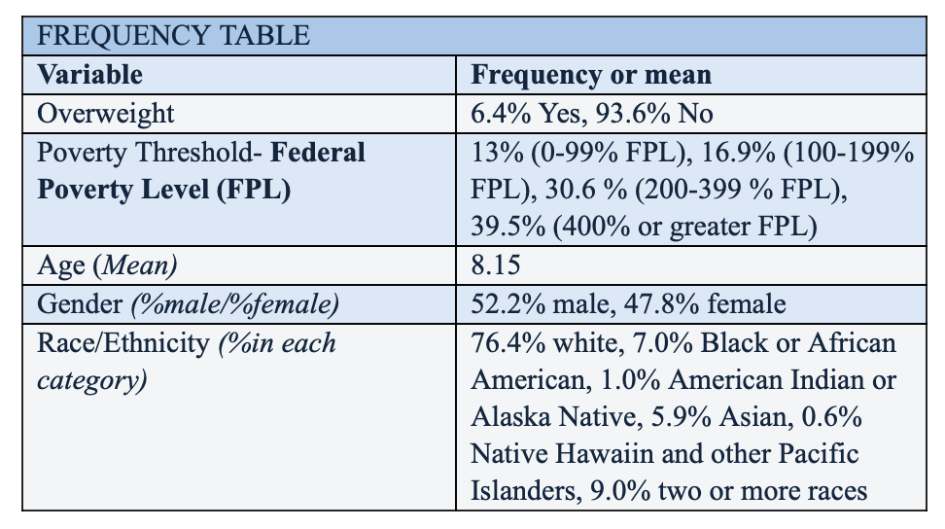
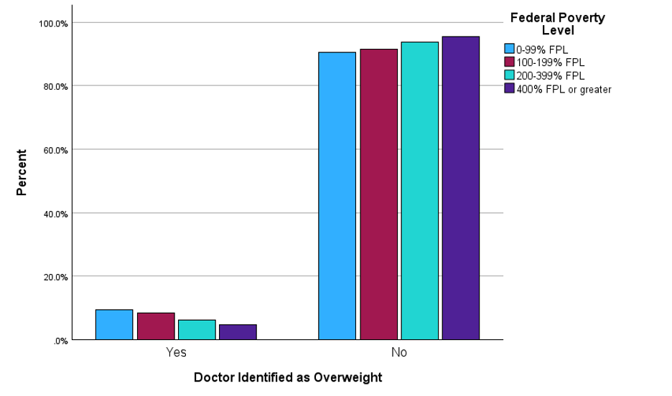
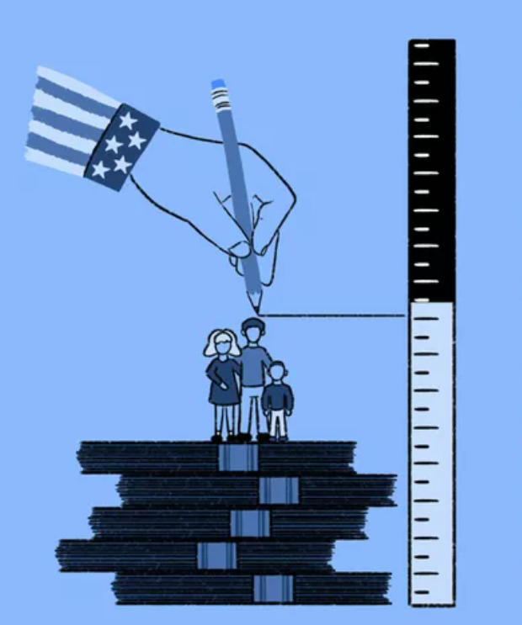
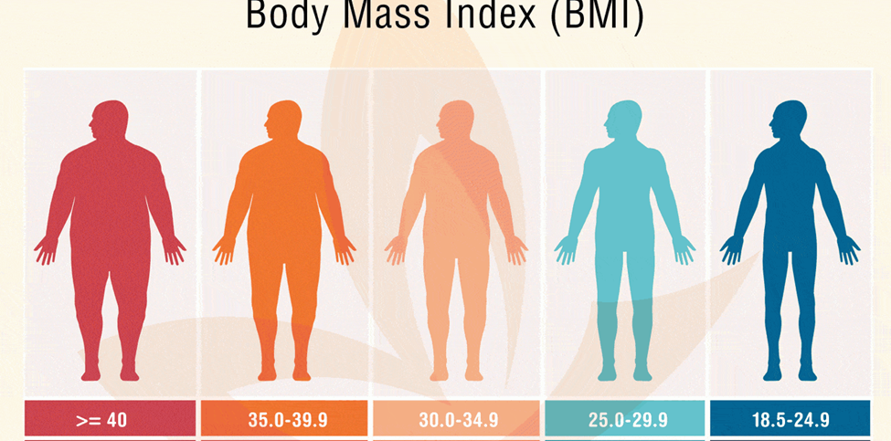
Poverty's Role in Shaping the Childhood Obesity Epidemic
Leah Demko, Megan Gaffney, Abigail Hudson, Katherine Mazzarelli, & Sabrina Palen
Department of Health Sciences, Sacred Heart University
Background
Methods
Results
Conclusion
390 million children and adolescents were overweight aged 5-19 (WHO, 2024)
160 million of those were obese (WHO, 2024)
Obesity is identified as a Body Mass Index (BMI) > 30.0. (CDC, 2024)
BMI is calculated using an individual's height and weight measurements
Several factors affect obesity in children, specifically socioeconomic (SES) factors (NIH, n.d).
Factors of SES include education levels, income, food and housing insecurity, and employment status.
Observational secondary analysis
Cross-sectional data from the National Survey of Children's Health (NSCH) 2021 data
Participants
- Total sample size: N= 20,198
United States children, ages 5 - 12
White, Black or African American, American Indian or Alaska Native, Asian, Native Hawaiian and other Pacific Islanders, and two or more races
Measures
Outcome of interest:
"Doctor Identified as Overweight"
Exposure:
"Federal Poverty Level"
Analysis
Descriptive statistics (frequencies) and ran a crosstabulation with chi-square models
Descriptive Statistics
The frequency of those overweight was 6.4%
The frequency of those living below the poverty line was 13%
The results of this study showed that there is a strong, direct relationship between Federal Poverty Level and childhood obesity.
The findings of the study were parallel to the literature found
Lower poverty levels were correlated to increased obesity rates (Inoue et al. 2023).
Strengths
Large sample size that encompasses a broad spectrum of participants across every FPL
Limitations
Reliance on observational data induces the possibility of bias
Reliance on self-reported measures may introduce inaccuracies
Suggested future research: gender, race, or ethnic differences.
Table 1: Children classified as overweight by a doctor and family federal poverty level, of 20,198 participants
Objectives
Inferential Statistics
To explore the relationship between socioeconomic status and childhood obesity rates among children in the United States.
References
Centers for Disease Control and Prevention [CDC]. (2024). Body mass index (BMI). Centers for Disease Control and Prevention. https://www.cdc.gov/healthyweight/assessing/bmi/index.html
Inoue, K., Seeman, T. E., Nianogo, R., & Okubo, Y. (2023). The effect of poverty on the relationship between household education levels and obesity in U.S. children and adolescents: An observational study. The Lancet Regional Health - Americas, 25, 100565. https://doi.org/10.1016/j.lana.2023.100565
National Cancer Institute [NIH]. (n.d.) NCI Dictionary of Cancer terms. https://www.cancer.gov/publications/dictionaries/cancer-terms/def/socioeconomic-status
World Health Organization [WHO]. (2024). Obesity and overweight. World Health Organization. https://www.who.int/news-room/fact-sheets/detail/obesity-and-overweight
Figure 3: Bar chart analysis showing the correlation between low family poverty levels and overweight children
Figure 1: Measure of Federal Poverty Line (FPL) made by the government (Investopedia)
9.4% of children living below the poverty line were overweight compared to 4.6% in the FPL or greater
A Chi-squared test showed a p-value of <0.001, a statistically significant relationship between family federal poverty levels and overweight children
Hypothesis
Family federal poverty level is significantly associated with being overweight among children in the United States ages 5 to 12 years old.
Figure 2: Body Mass Index (BMI) ranges indicating each category on the BMI scale (Pharmacy Digital Library)
Notes:
‌

