Slide 1
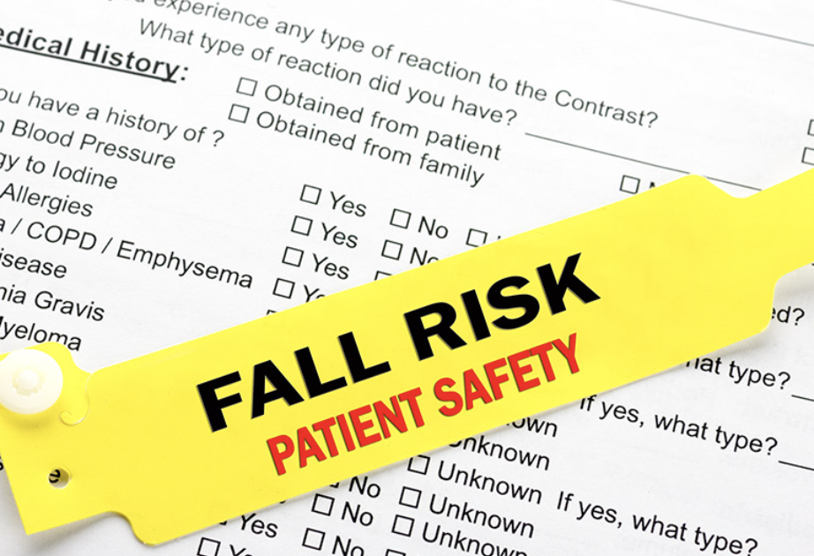
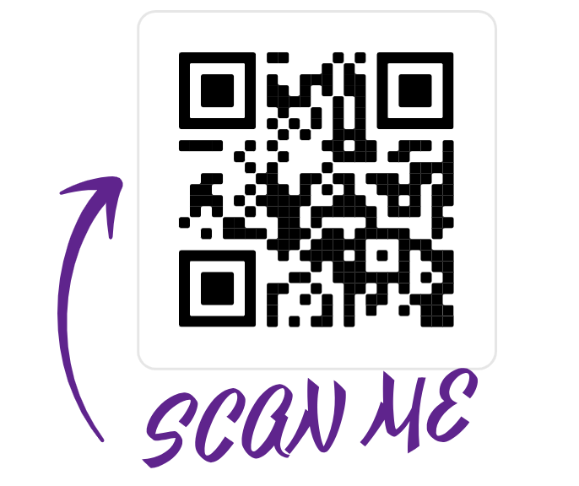
“The fall death rate increased by 41% from 2012 to 2021” (Centers for Disease Control and Prevention, 2023).
Evidence-Based QI: Evaluation of Falls Prevention Tools
Isabella Guarente, SN
Nursing Major Nutrition Honors Minor
DHCON Faculty Mentor: Dr. Theresa Soltis, DNP, APRN, FNP-BC
Introduction. A fall is defined as “sudden, unintentional, and unexpected movement from orthostatic position, from seat to position, or from clinical position” (Strini et al, 2021). Patient falls are unexpected and can lead to injuries, worsening of condition, and even death. It is important to recognize those at risk for falls and this can be achieved by using the Morse Fall Scale, John Hopkins fall risk assessment, and Hendrich II fall risk factors to indicate which patients can be identified as a high fall risk and should be watched closely.
Appraisal of Systematic Review. Researchers used 115 studies in the qualitative synthesis, including prospective cohort or cross-sectional studies and correlates to a Level 3 evidence. Results indicated that there is no “ideal” tool that can be used in any context or that performs a perfect risk assessment, instead a simultaneous application of multiple tools is recommended.
Appraisal of Single Quantitative Research Article. The main purpose of this study was to identify the best fall risk assessment tool from the Morse Fall Scale, the John Hopkins fall risk Assessment Tool, and the Hendrich II fall-risk. After using the three tools, the study identified the most prevalent risk factors to be “gait, dizziness or vertigo, changes in mental status, impulsivity, history of falling, elimination disorder, drugs affecting falls, and depression” (Cho et al., 2020). The conclusion of the study is the Hendrich II fall-risk Model had the best predictive performance for falls between the three tools.
Research Question. In adult hospitalized patients, how does introducing the Morse Fall Scale, John Hopkins fall risk assessment, and Hendrich II fall risk factors compare with not using a fall risk prevention scale affect the decreased number of falls among hospitalized patients?
Conclusion & Relation to Nurse. The recommendation for patient care is to supplement the Morse Fall Scale with the four most significant fall risk predictors identified in this study. This includes gait, dizziness or vertigo, change in mental state, and a history of falling. Nurses can use these studies to help identify high fall risk patients and prevent falls.
To read more…

