Slide 1
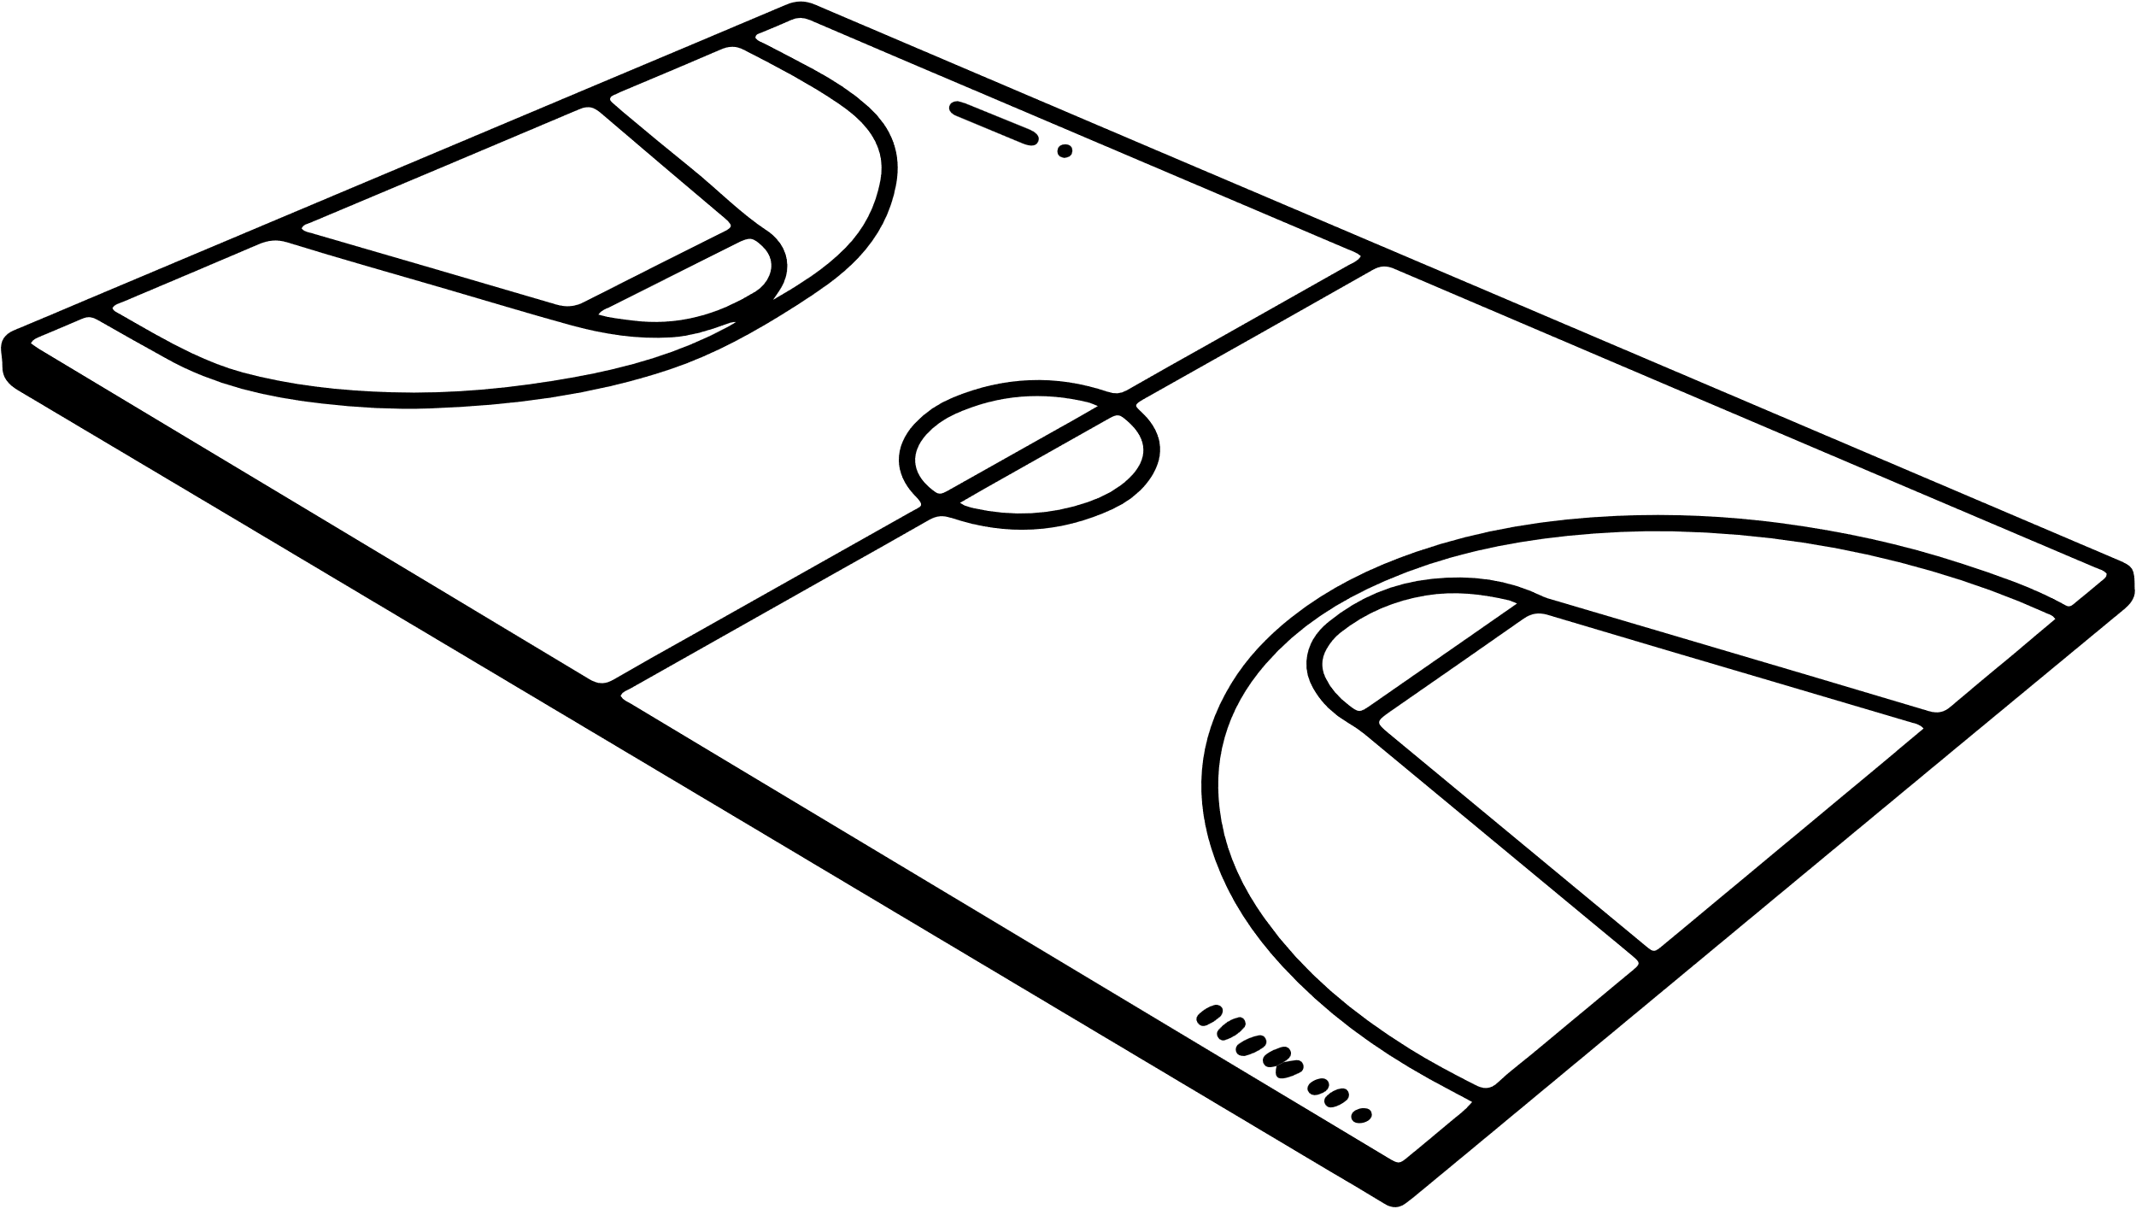

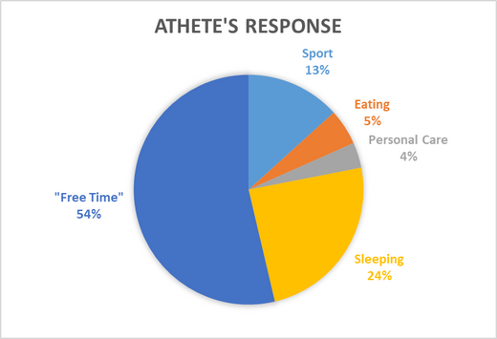

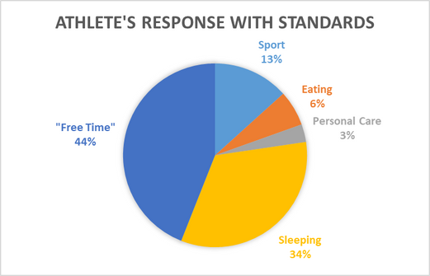
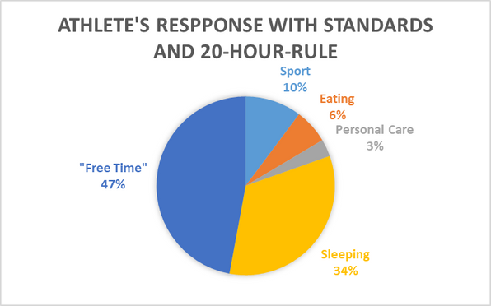
Introduction
Methodology
Findings
Purpose:
The purpose of this project is to raise attention to the NCAA Hour Rule for athletes which is overlooked and abused.
Problem:
With so many hours spent on practice and team commitments, players have little time left for school, internships, health, or extracurriculars.
Solution:
Our goal is to gather information from players about their weekly schedules to show the NCAA how the hour rule is getting overlooked and needs change.
Data Collection:
I interviewed student-athletes at Sacred Heart University to get data on how many hours were dedicated to their sport per week and their “free time.”
Interview Information:
  Class Schedule
  Time spent on:
    Sport
    Eating
    Personal Care
    Sleeping
    Homework/Studying
    Job/Internship
    Extra Curriculars
    Rehab/AT/Therapy
    Commuting

