Slide 1
Getting Started in the Library
A Sacred Heart University Colloquium on Information Literacy
October 3, 2012
By Amy Jansen

Slide 2
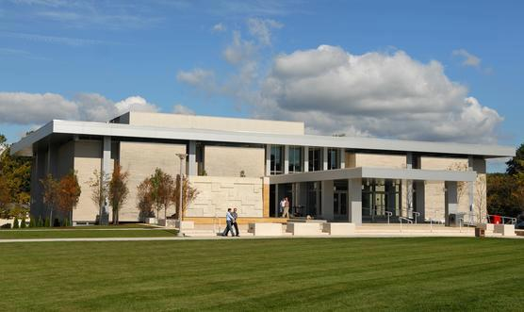
Where is the SHU Library? How is it organized?
Most know its physical location and how to find the Library Café, but there is much more to the SHU Library and its resources are absolutely vital to succeeding in your academic career.
Let’s start with our new SHU Library Tour video: http://www.youtube.com/watch?v=WN-PfZFTuEc

Slide 3
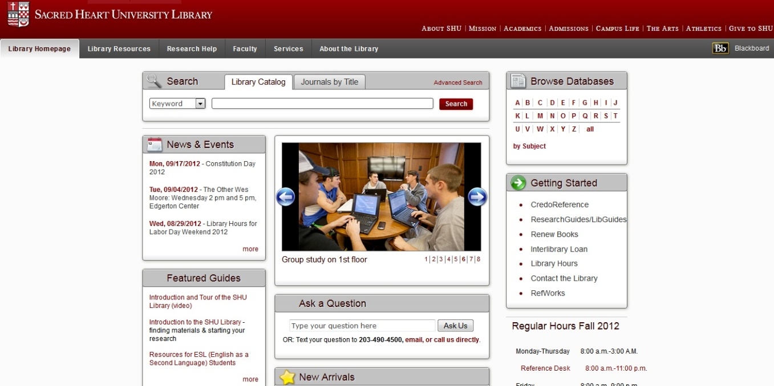
How do I get to the library website?
http://library.sacredheart.edu/ - this is your portal to a vast array of resources

Slide 4
What can you do from the library website?
Search the library catalog (books, multimedia, & journals that we own)
Search article or specialized research databases
Get help with citations and access RefWorks (online citation manager available to SHU students & faculty)
View online research guides which are specifically devoted to your classes or majors (LibGuides)
Submit an online form for special help with your research
Place an interlibrary loan request
Renew your books
Ask a librarian a question (can receive answers via text or email)
Access online reference sources (yes, those huge sets of print encyclopedias are now online!)
Check out our Digital Commons, a digital forum for papers published by the SHU Community

Slide 5
How do I find a book?
Use the Library Catalog to search our collection of over 226,000 books, videos, journal titles, and other resources, including links to over 73,000 electronic books and 33,000 electronic journals.
Keyword searching is a good way to start, although of course, if you are seeking a certain title or books by a certain author, use the title or author search.

Slide 6
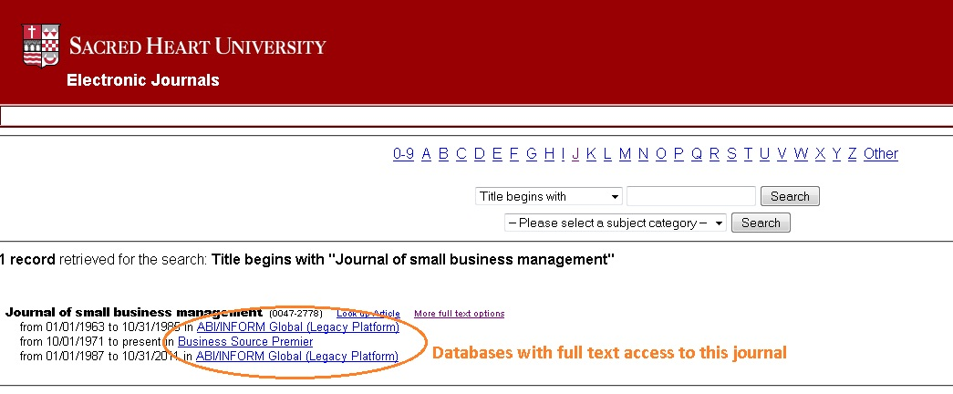
How do I find an article?
If you know the name & source of an article, go directly to our catalog and search by Journals by Title.
You will be linked to any database that has full text contents of that journal.

Slide 7
IF you are searching for certain topic or issue, identify which database you would like to search. You can check our Database A-Z list or our Databases by Subject web pages.

Slide 8
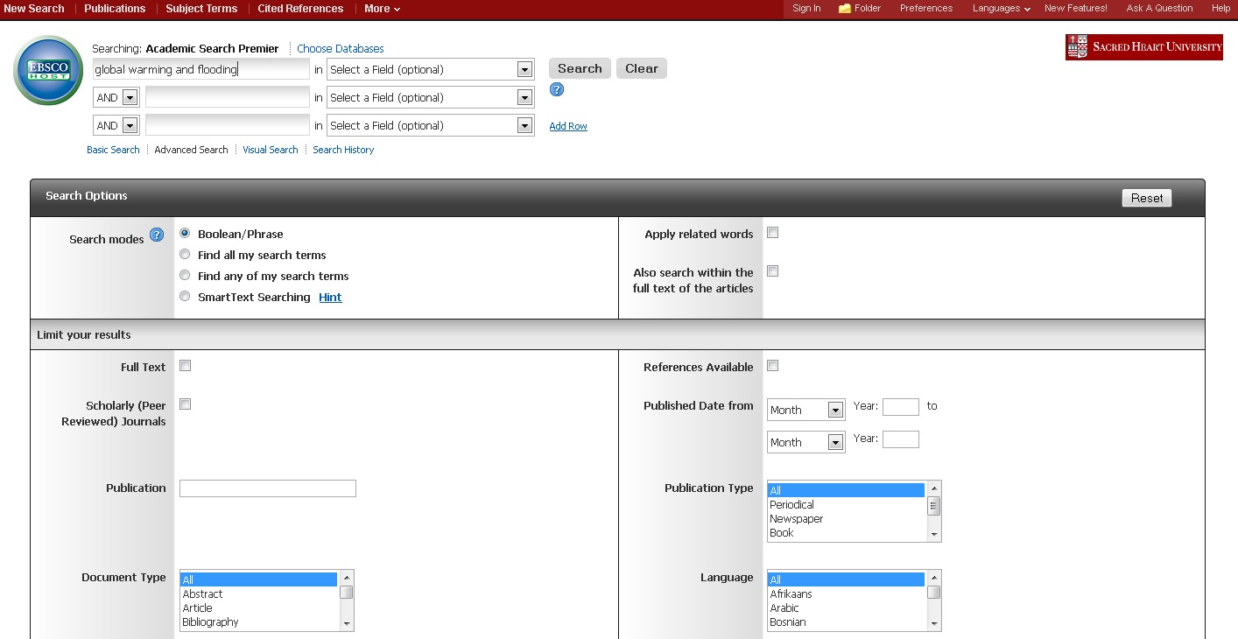
Multidisciplinary databases, like Academic Search Premier, are a good place to begin, or if you are uncertain as to which database might fit your topic.

Slide 9
How do I know if my source is a good one?
Authority…Reliability…Credibility
The author is a well-known, well-respected expert in the field.
The material has been peer-reviewed, which is a process of subjecting an author’s scholarly work or ideas to the scrutiny of others who are experts in the field. Articles from peer-reviewed journals have been reviewed by other scholars in the field before publication.
You have reason to trust that the information is accurate.
The bibliography indicates that the author did sufficient research before writing this book, article, or website.
The information is up-to-date relative to other research in the field.
Perspective…Objectivity…Purpose
The book, article or website addresses your research topic.
The information is presented fairly, with all sides of the argument considered and given equal treatment.
If only one side or perspective of a topic is addressed, the author makes this clear to the reader.
The information thoroughly and accurately covers the topic, does not omit or ignore facts to support argument.
It is not superficial information.

Slide 10
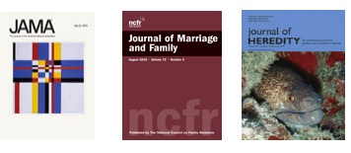
Scholarly vs. Popular Sources
Scholarly Journals
Expert or scholar authors
Other scholars review articles before publishing
More specialized, research topics
Thorough citations & lengthy bibliographies
Audience: scholars and students
Popular Magazines & Newspapers
Journalists or non-academic general authors
Content reviewed for appeal & popularity, but not as a contribution to field of study
Broad, “light,” or popular topics
Few or no citations
Audience: general public

Slide 11
What do all of those library terms mean?
Boolean Searching – A system of logic that allows the user to combine words or phrases representing key concepts when searching in a library database or the library catalog (i.e. “global warming and flooding”; “football or soccer not sports” – and, or, not are the Boolean operators).
Catalog – A comprehensive list of the books, videos, journals and other materials in the library collection; most, including SHU Library’s, are searchable online.
Database - Databases are online resources that the library subscribes to that contain articles and other information from a wide range of sources, such as magazines, newspapers, journals and reference books.
Interlibrary Loan (ILL) - When a book, journal article or video needed by a student or faculty member is unavailable, the student may request that it be borrowed from another library by submitting this online form.
Journal - A periodical (something that is regularly published, unlike a book which is usually published just once) devoted to publishing original research and commentary on current developments in a specific field of study.
Reference Book - A book designed to be consulted for authoritative background information or topic definitions rather than read cover to cover. Print reference books are shelved in the reference room and have to be used in the library—they cannot be checked out. The SHU Library also makes available a number of online reference sources through Credo Reference & CQ Researcher that can be used from any computer, either on-campus or off-campus (with your network login/password).
Truncation - The dropping of characters and the addition of a symbol at the end of a word in a keyword search to retrieve other forms of a word (i.e. adolescen* to search for adolescent, adolescents and adolescence).

Slide 12
How do I find help with citing sources?
In academic writing, it is VERY important to properly cite your sources.
Citation Quick Guides
MLA
APA
Chicago
RefWorks: a citation management tool
import references from electronic databases and catalogs or enter manually and format them in a wide variety of citation styles
Store all of your citations online
Zotero: free, easy-to-use Firefox extension to help you collect, manage, cite, and share your research sources

Slide 13
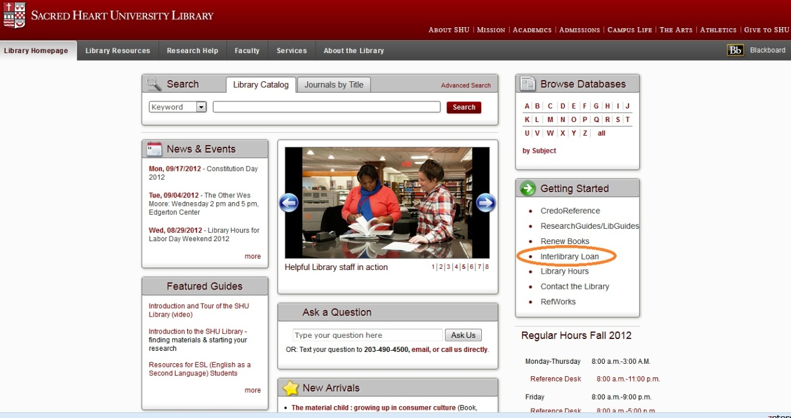
I need a book or article that SHU Library does not have, how can I get it?
Interlibrary Loan is a service that makes it possible for SHU students, faculty, and staff to obtain copies of books, articles, and other library materials that are not owned by SHU from other libraries.

Slide 14
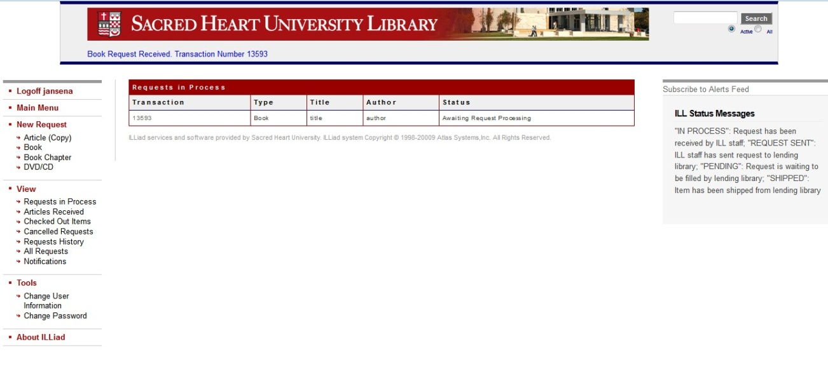
Your ILL username/password is not automatically set up for you, you will have to establish this yourself on our ILL website (ILLiad).
Once your book or article arrives, you will receive an email notification.
You can check back on ILLiad for your request’s current status.

Slide 15
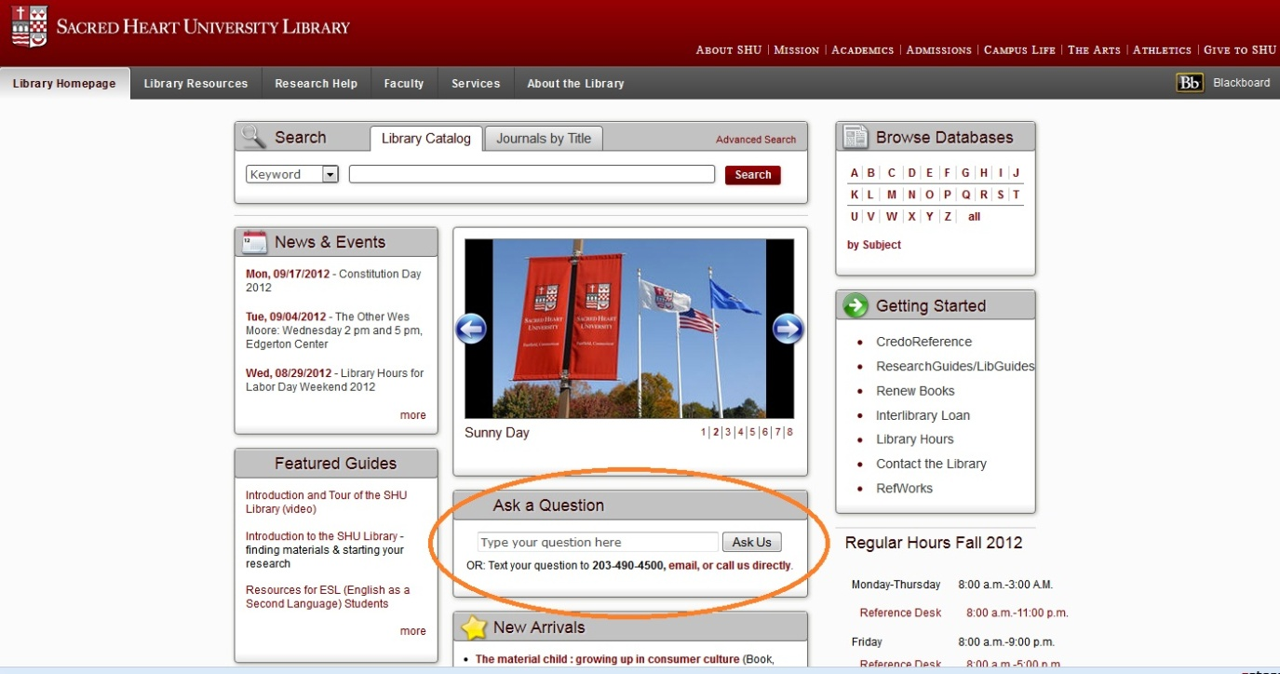
I really need more specialized help with my research, where do I go?
Contact the Reference Desk, there are lots of ways!
Visit us in the library or call 203-371-7726
Email reference@sacredheart.edu or text 203-490-4500
Submit a question on our FAQs/online form: http://libanswers.sacredheart.edu/search.php

Slide 16
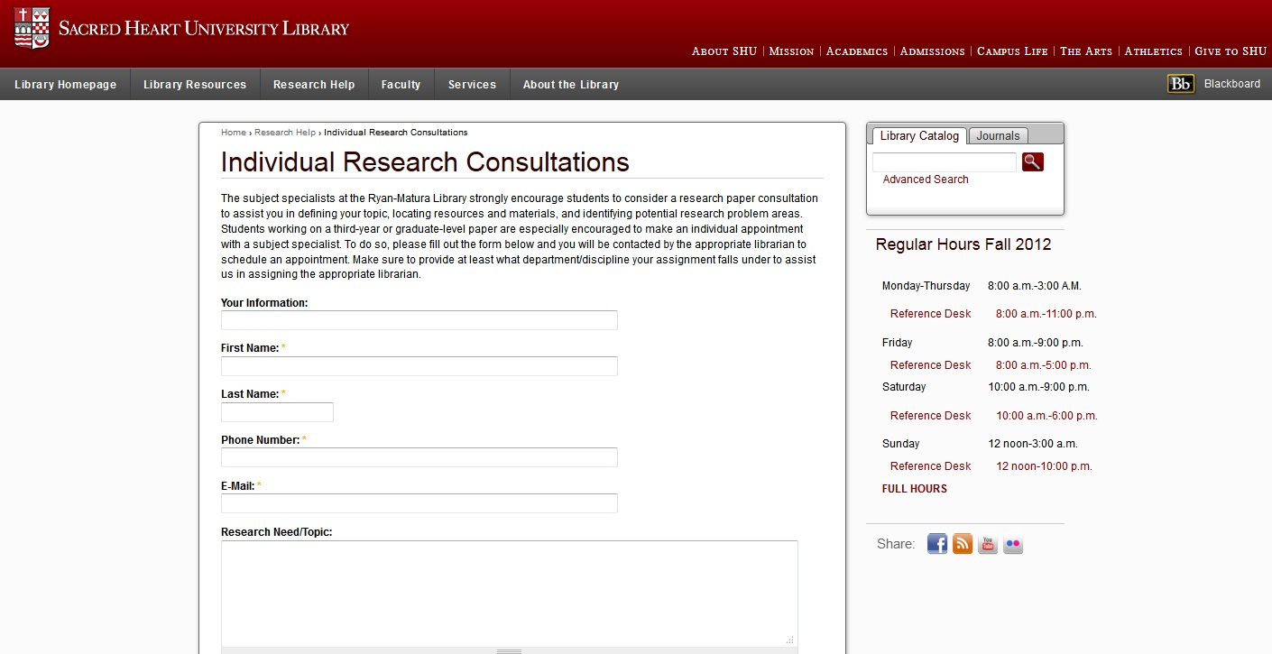
OR request a research consultation with a librarian in your subject area (just specify your major, course, or assignment)
Online form at: http://library.sacredheart.edu/Individual_Research_Consultations

Slide 17
Questions?
We are here for you! Please don’t hesitate to ask for help.
If you would like a copy of this PowerPoint presentation, please email me at jansena@sacredheart.edu.

Slide 18
Upcoming Information Literacy Colloquia
Academic Integrity & Copyright – Robert Berry
Wednesday, Oct.24, 3:30-4:30 pm, Curtis Hall Theatre
Evaluating Sources of Information on the Web – Kim Macomber
Wednesday, Nov. 7, 3:30–4:30 pm, University Commons
Research Databases – Libby Knapik
Wednesday, Nov. 14, 3:30–4:30 pm, University Commons

