Slide 1
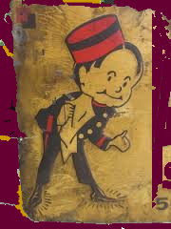
Searching USPTO Trademark Records
Amy Jansen & Rob Berry
2013

Slide 2
Today we are concerned Primarily with Trademarks & Service Marks
These marks include “any word, name, symbol, or device or any combination thereof” used by a person to identify her goods or services and to distinguish them from the goods or services of others.*
Other registered marks include certification marks (used to certify region, quality, accuracy, &c.) and collective marks (indicating membership in a group).
* Lanham Trademark Act of 1946, Section 45 (Definitions), codified at 15 U.S.C. § 1127.
State of Idaho Potato Com’n v. G&T Terminal Packing, Inc, 425 F.3d 708 (9th Cir. 2005)
International Order of Job's Daughters v. Lindeburg & Co., 633 F.2d 912 (9th Cir. 1980)

Slide 3
You do not need to register a mark to use “TM” or “SM” or to enjoy a basic level of common law protection
In addition to federal registration (for marks used in interstate commerce), marks may be registered with state registries or with foreign governments.
Connecticut trademark resources are found on the Secretary of State Commercial Recording Division Forms Index page.

Slide 4
There are important advantages to federal registration
Federal registration provides nation-wide notice that you are claiming the right to use the mark.
Federal registration creates a legal presumption that your mark is valid.

Slide 5
Trademarks are highly relevant to today’s business world (See US Trademark, Registration No. 8328050 (“Freestyle” + Design) & US Patent No. US8328050 (Dispensing nozzle assembly))

Slide 6
There are four steps to registering a trademark
(1) Clearance (making sure your mark is not likely to be confused with existing marks);
(2) Filing;
(3) Responding to Office Actions; and
(4) Post-registration activities.
Our primary role as a PTRC to assist people in conducting a preliminary search, which is an important first step in the clearance process.
An important additional role is to help patrons locate information on filing, responding to office actions, and maintaining/renewing their marks.

Slide 7
Because marks are used to identify and distinguish, they must be (1) Inherently distinctive; and (2) Not likely to be confused with existing marks
Courts recognize a hierarchy of (inherent) Distinctiveness:
Fanciful marks (Xerox, Polaroid) and Arbitrary marks (Black and White Scotch, Victoria’s Secret) are highly distinctive;
Suggestive marks (Coppertone, Orange Crush) are also inherently descriptive;
Descriptive marks (Dyanshine shoe polish) must acquire secondary meaning to be registered; and
Generic marks, including laudatory terms like original or super, cannot be registered (e.g., Duck Tours was held to be generic*).
* Boston Duck Tours, LP v. Super Duck Tours, LLC., 531 F.3d 1 (1st Cir. 2008)
Sara Lee Corp. v. Kayser-Roth Corp., 81 F.3d 455 (4th Cir. 1996)

Slide 8
Descriptive can be registered if they (can be shown to) have acquired Secondary meaning
Grove Laboratories v. Brewer & Co., (1st Cir. 1939) (Interpreting The Trademark Act of 1920)
Burke-Parsons-Bowlby Corp. v. Appalachian Log Homes, Inc., 871 F.2d 590 (6th Cir. 1989)

Slide 9
Applicants may disclaim the exclusive right to use A descriptive word that forms part of a mark
Disclaimer: NO CLAIM IS MADE TO THE EXCLUSIVE RIGHT TO USE "BARBELL" APART FROM THE MARK AS SHOWN.
“Where the proposed mark consists of but two words, one of which is disclaimed, the word not disclaimed is generally regarded as the dominant or critical term in determining the distinctiveness or suggestiveness of the proposed mark.”*
Champion Barbell, U.S. Trademark, Registration No. 3795882
* Pizzeria Uno Corp. v. Temple, 747 F.2d 1522, 1529-30 (4th Cir. 1984)

Slide 10
There are a number of grounds for refusing to register (or to cancel) a mark
Sections 2 and 45 of the Lanham Trademark Act of 1946* sets forth several grounds for refusing to register a mark on the principal register.
One such ground is non-use, as where a trademark was never used or was discontinued.
Applicants can file an intent-to-use application.
* codified at 15 U.S.C. §§ 1152, 1127
Lens.com, Inc. v. 1-800 Contacts, Inc., 686 F.3d 1376 (Fed. Cir 2012)

Slide 11
Trademarks consisting of scandalous matter are refused under Section 1052(a)
Section 1052(a) refusals also cover , inter alia, marks that consist of immoral or deceptive matter or matter which may disparage or falsely suggest a connection with persons (living or dead), institutions, beliefs, or national symbols.
In Pro-Football, Inc. v. Harjo, seven Native Americans moved for cancellation of six Redskins trademarks claiming the marks were scandalous and disparaged Native Americans. The case was dismissed due to laches (delay in bringing the action).
15 U.S.C. § 1052(a)
Pro-Football, Inc. v. Harjo, 567 F. Supp. 2d 46 (D.D.C. 2008)

Slide 12
Trademarks consisting of flags & insignia of sovereign states are refused under 1052(b)
De Nobili v. Scanda, 198 F. 341 (D.C. Pa. 1912)
Durable Toy & Novelty Corp. v. J. Chien & Co., 47 F. Supp. 167 (S.D.N.Y. 1942), rev’d on other grounds 133 F.2d 853 (2d Cir. 1943)

Slide 13
Trademarks consisting of the name, portrait, or signature of a living person without consent are refused under 1052(c)
Gilbert/Robinson, Inc. v. Carrie Beverage-Missouri, Inc., 989 F.2d 985 (8th Cir. 1993)
The Herbert Hoover Presidential Library Publishes Hooverball Rules on its website

Slide 14
marks which so resemble a previously registered mark as to be likely to cause confusion (in light of the marks’ sight, sound, meaning, and commercial impression) are refused under 1052(d)
Anthony's Pizza Holding Co., Inc. v. Anthony's Pizza & Pasta Intern., Inc., 415 Fed. Appx. 222 (Fed. Cir. 2010)
US Trademarks, Registration Nos. 2,661,703 and 3,073,126

Slide 15
The Same or similar marks do not necessarily create a likelihood of confusion, as where entirely different goods & Services are marketed to dissimilar consumers through distinct channels of trade.
Superball, U.S. Trademark, Registration No. 77234204
Superball, U.S. Trademark, Registration No. 1614675

Slide 16
The exception is that a likelihood of confusion may still be found where a famous mark is involved

Slide 17
Once a trademark application has been filed, be wary of Third-Party Solicitations
As the USPTO’s Non-USPTO Solicitations page warns, the public information submitted as part of a trademark application provides a basis for official-looking offers:
“(1) for legal services; (2) for trademark monitoring services; (3) to record trademarks with U.S. Customs and Border Protection; and (4) to ‘register’ trademarks in the company’s own private registry.”
The USPTO’s Non-USPTO Solicitations page includes several examples.
USPTO, WARNING: Non-USPTO Solicitations That May Resemble Official USPTO Communications.

Slide 18
A preliminary search versus a Clearance Search
A preliminary search covers the USPTO database for federally registered trademarks.
This can be done using resources at www.uspto.gov.
A clearance search covers the USPTO database for federally registered trademarks plus additional sources of information, such as:
Pending applications;
State registries;
State entity name registries;
Internet domain registries;
TTAB references; and
Uses on Internet, trade magazines, etc.
Typically this is done using a commercial service (such as Corsearch, Thompson & Thompsons, or TrademarkExpress) and could cost $400 to $800, or more for complicated searches.

Slide 19
Things to be aware of:
Registering a business name or a domain name does not give you protection under the Lanham Act.
During the application process the applicant must monitor the status of application and timely respond to USPTO filings.*
After registration issues, the register owner must file specific documents and pay fees at regular intervals or the mark will be deemed abandoned.**
Make sure to use http://www.uspto.gov/ (not https).
We help people learn how to search, but we do not do their search for them.
In the United States (as opposed to many foreign countries) you can only list goods and services you are actually providing in a trademark application (or the mark can be cancelled as fraud by the Patent & Trademark Office).
See USPTO * Trademark Process and ** Maintain/Renew a Registration: How to Keep a Registration Alive

Slide 20
Identify your mark
Does it contain only standard characters (words, letters, or numbers)?
Or does it have a design element, as in, you wish to protect the appearance of the mark?
Is it a sound?
Note: standard characters & designs cannot be combined in one trademark.

Slide 21
Acceptable ID of Goods & Services Manual
Use this manual to locate specific terms that describe your product or service: http://tess2.uspto.gov/netahtml/tidm.html

Slide 22
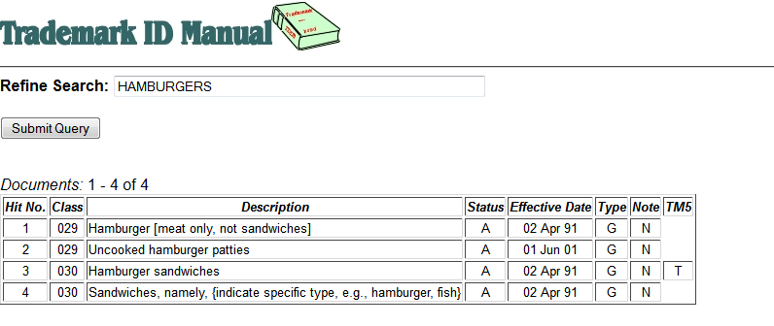
Using the Goods & Services Manual
Perform a keyword search:
OR, browse the content:

Slide 23
USPTO Trademark Information Network’s ‘Goods & Services’ video

Slide 24
INTERNATIONAL CLASSES
If you use a term from the G & S Manual, the International Class appears next to the entries.
Entries designated with a "T" in the "TM5" field are entries acceptable in the USPTO, the Japanese Patent Office ("JPO"), the European Trademark Office ("OHIM", the Office of Harmonization in the Internal Market), and the Korean Intellectual Property Office ("KIPO").
If you make up your own term, you can find the appropriate class in the International Schedule of Classes of Goods and Services.
Using the International Class helps focus a search, but the International Class is not required on the application.

Slide 25
Basic Mark Searching
Review the common reasons the USPTO rejects a trademark (mentioned earlier).
Think of alternative ways to present your mark in case your first choice is already taken.
If you plan to use a phrase, search using the key words.
The New User (Basic) search form allows for searching of the most commonly searched fields: word marks, serial or registration numbers, and owners.
The Combined Word Mark is the default search field and includes the word mark and translation.
Use the $ for truncation in any field. For Combined Word Mark searches, the * is a more efficient truncation operator for left and/or right truncation.

Slide 26
Broaden your Search
Thinks of ways another mark may be similar to your own, including:
Shortened versus longer versions: Net for Internet
Similar meaning: Green Stick, Green Twig
Similar sound or appearance including homonyms:
Color Time, Colour Thyme
Scream'n and Screaming

Slide 27
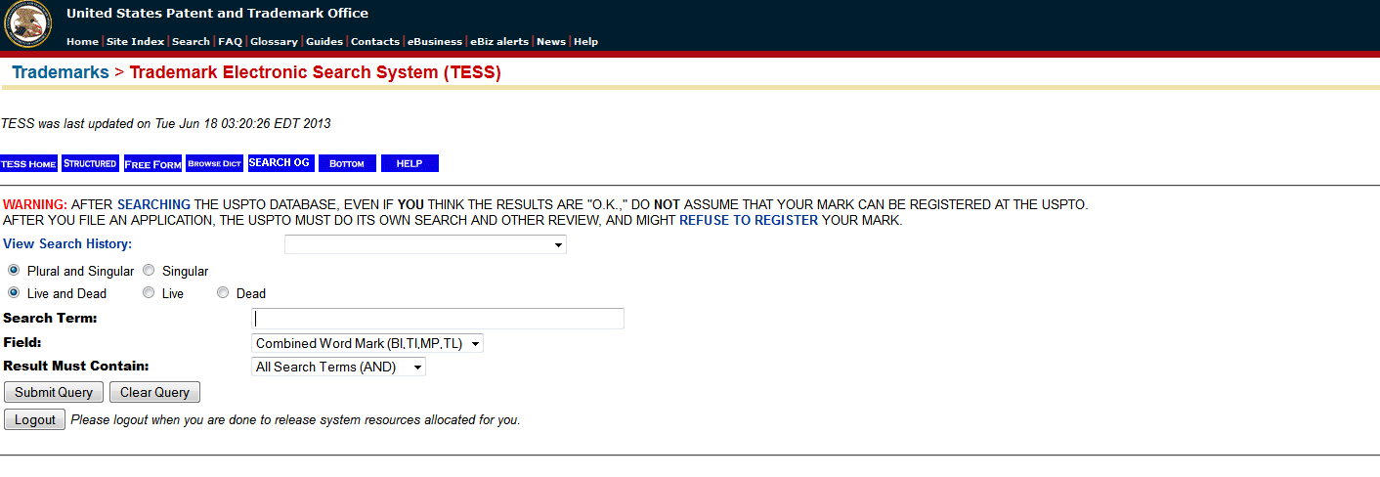
Searching TESS
Access TESS (Trademark Electronic Search System)
Click on the Basic Word Mark Search (New User) – note: this only searches word marks.

Slide 28
With Basic Search, notice the default selections are "Combined Word Mark" and "All Search Terms." Examine the various alternatives in the pull down boxes.
Enter your key term(s) in the search box. Remember also to test the alternatives from your broadened search ideas.
Once you are comfortable doing the basic search, try the Word and/or Design Mark Search (Structured). This allows you to search both word & design marks together.
Remember to log out when you are finished with your searching to free resources for others.

Slide 29
Trademark records
A typical trademark record includes searchable fields for the word mark (including translations where applicable), goods and services classifications, goods and services descriptions, design elements, owner information, etc.

Slide 30
Search logos and designs
Search the Design Code Manual, if your mark contains: 1. Word marks conveying a strong visual image, or 2. Designs or logos without text.
The design code manual combines a design classification system with exemplars and an index.

Slide 31
The design code Manual uses three levels of classification
04.01.06 corresponds to 04. (Supernatural beings, mythological or legendary beings, fantastical beings or unidentifiable beings ) 01. (Winged or horned personages, fairies, supernatural beings, mythological or legendary personages) 06 (Leprechauns, elves, gnomes)
19.05.01 corresponds to 19. (Baggage, containers and bottles) 05. (Large containers) 01 (Barrels).

