Slide 1
Patent Searching using the USPTO Public Website
Amy Jansen & Rob Berry
Wednesday July 10, 2013

Slide 2
The USPTO.gov website features a variety of useful tools:
Such as
The United States Patent Classification (USPC) and tools to search USPC definitions;
The New Cooperative Patent Classification (CPC) tools to search CPC definitions;
Patent Databases that can be searched using USPC, CPC, or a variety of other fields; and
The Manual of Patent Examining Procedure,
to name a few.

Slide 3
The Granting of Patents is Authorized and Regulated under Federal Law
U.S. Const. art I, § 8, cl. 8 grants to Congress the power to “To promote the Progress of Science and useful Arts, by securing for limited Times to Authors and Inventors the exclusive Right to their respective Writings and Discoveries.”
This “Intellectual Property Clause” allows Congress to create laws governing Patents and Copyright.

Slide 4
A Preliminary Patent Search helps Patrons: US Patent 1,627,865 for an Eskimo Pie Vending Machine
Conduct a Preliminary Prior Art Search (to determine the originality of their invention);
Research a class or classes of inventions; and
Better understand patent documents.

Slide 5
The first American patent law was the Patent Act of 1790, 1 Stat. 109-112 (April 10, 1790).
The first members of the Patent Board were the Secretary of State (Thomas Jefferson), Secretary of War (Henry Knox), & the Attorney General (Edmund Randolph).

Slide 6
The first Patent granted under the 1790 act was US Patent Number X000001,
● Patent No. X000001: “Improvement … in the making of Pot ash and Pearl ash, by a new Apparatus and Procefs.”
● X Patents: issued between 1790 & 1836 (identified by title and date issued).

Slide 7
The X Patents were destroyed in a December 15, 1836 fire, as detailed, for example, in Burlington Free Press on December 23 of that year.
Close to 10,000 documents destroyed.
Approximately 2,800 of these X Patents have been located.
Subsequent Patents were sequentially numbered beginning with 1.

Slide 8
Some X Patents are incomplete. X Patents may also have fractional numbering, used to preserve the sequence of documents.

Slide 9
The reissued X Patents include Patent X72 (Eli Whitney’s Cotton Gin) & Patent 983X (an early 19th century washing machine)

Slide 10
Patents are creatures of federal law, and specifically Title 35 of the United States Code
An important provision of Title 35 is Section 101:
35 USC 101 Inventions Patentable.
This section limits the scope of what can be protected by patent law to inventions that are new, have utility, and are non-obvious
Chapter 2100 of the MPEP discusses Patentability in detail.

Slide 11
It is important to remember that the scope of what can be patented is defined by law, see 35 U.S.C. § 101 (Inventions patentable).
To be patentable, claims must be (1) new, (2) useful and (3) non-obvious.
[USPTO MPEP at § 2106 http://www.uspto.gov/web/offices/pac/mpep/mpep_e8r6_2100.pdf]

Slide 12
Things that cannot be Patented include:
Laws of nature (such as E=mc² or Newton’s Law of Gravity)
Physical Phenomena (such as a newly discovered mineral or plant)
Abstract Ideas (such as concepts related to hedging risk reduced to a mathematical formula)
[Diamond v Chakrabarty, 447 U.S. 303, 309 (1980); Bilski v. Kappos, 130 S.Ct. 3218, 3231 (2010) Doris Ulmann, Albert Einstein (1931) Prints & photographs, PR 13 CN 1975:127]

Slide 13
To Determine if a Claimed Invention is New a Patent Examiner Searches “Prior Art.”
Prior Art refers to all information that has been published concerning the relevant Scientific and Technological principles claimed.
The concept is much broader than a Preliminary Search of the USPTO database.

Slide 14
A Preliminary Search of the USPTO Classifications and Databases is helpful:
As a first step in determining if prior art exists; and
As a way for patrons to educate themselves about a relevant class, or relevant classes, of inventions;
—We do not, however, conduct searches for patrons or opine as to the adequacy of their searches.
—We encourage patrons to keep their invention confidential.
—We show them a sample search (or searches) that we have familiarized ourselves with before the consultation so that they can conduct their own search with confidence.

Slide 15
Types of Patents
There are three types of patents:
Utility patents may be granted to anyone who invents or discovers any new and useful process, machine, article of manufacture, or composition of matter, or any new and useful improvement thereof. Here is the process for obtaining a utility patent.
Design patents may be granted to anyone who invents a new, original, and ornamental design for an article of manufacture.
Plant patents may be granted to anyone who invents or discovers and asexually reproduces any distinct and new variety of plant.

Slide 16
Searching for Patents
Step 1: describe invention, formulate keywords
Step 2: look up keywords in the U.S. Patent Classification System (USPC)
http://www.uspto.gov/web/patents/classification/uspcindex/indextouspc.htm
If you cannot locate your keywords, you can 1. scan class titles & descriptions to determine where the invention may fit or, 2. run a keyword search in the patent database & scan retrieved patents for their classifications (note that you cannot pull up pre-1976 patents via a keyword search, these are searchable only by Issue Date, Patent Number, and Current US Classification.)

Slide 17
Classes & Subclasses
Step 3: Locate classifications in Class Schedule - click on the hyperlinked classification number from the USPC OR http://www.uspto.gov/web/patents/classification
Step 4: Read class & subclass definitions to get a sense of the scope of the relevant classifications
Click on the class or subclass number for full definitions
Or you can click on the hyperlinked description & then clicking “Show Definition View” from the pop up window

Slide 18
Browsing Patents in your Class/Subclass
Step 5: Once you have identified the relevant classes & subclasses, retrieve & review the patents associated with them, do this by clicking the small red “P” next to the class or subclass
This will pull up a list of patents that match that class/subclass (starting with most recent)
Full text will not be available for pre-1976 patents, but you can view the patent as a TIF file (required a TIF reader on your browser)
Step 6: Review patents & patent applications thoroughly

Slide 19
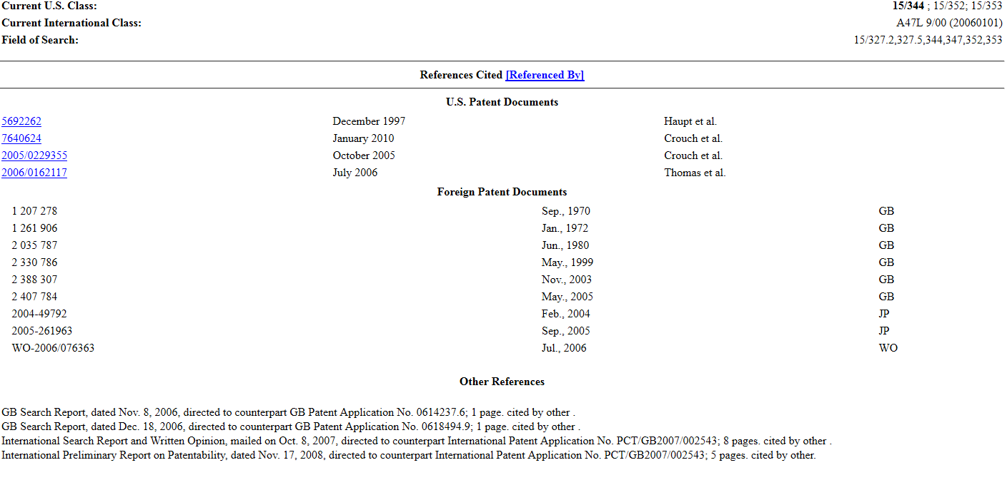
Examining a Patent & Reviewing Patent Citations
Step 7: Review references cited and field of search entries in relevant patent documents

Slide 20
Field Searching for Patents
Note that patents from 1790 through 1975 are searchable only by Issue Date, Patent Number, and Current US Classification (not keyword).
Quick Search page allows you to use two-term Quick search queries.
Advanced Search page allows you to make a query of the US Patent Full Text Database using command line search syntax (basically a more detailed, more refined search).

Slide 21
PubWest
PubWest – available in the PTRC room – is the public version of the Web-based Examiners Search Tool.
Has search features that expedite searching and include full-text access to U.S. patents from 1920 to today in addition to dedicated databases for searching non-U.S. patents and published patent applications.
Scheduled to be replaced by PubEast (a different, more user friendly search interface) within the next year.

Slide 22
What can a PTRC Library do?
“Though PTRC librarians cannot provide legal advice or conduct patentability prior-art searches, they can show you a recommended step-by-step approach to doing a thorough job of a preliminary search of U.S. patents and published patent applications using a generic example and how to search effectively for trademark registrations. The PTRC librarians can also provide help in accessing non-U.S. patents and published patent applications as well as non-patent literature, though this access will vary by library and may have associated costs.” – from the Inventor’s Eye, Dec. 2012, the USPTO's bimonthly publication for the independent inventor community

