Slide 1
Case Law Research using Westlaw Campus
Wednesday July 17, 2013

Slide 2
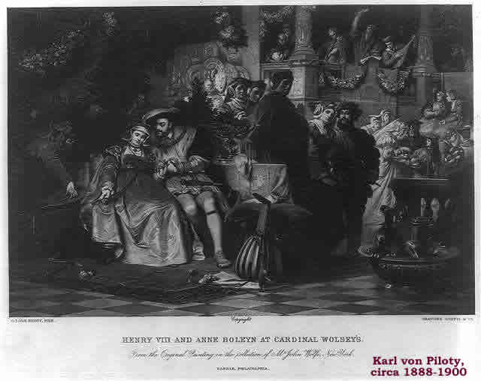
The Importance of Law
From a macro-perspective, law regulates the irrational tendencies of power by limiting the opportunities for power to be exercised in a purely arbitrary manner.
From a micro-perspective, law regulates conflicts by affording persons with mechanisms to resolve conflicts using a set of shared procedures and principles of proof.

Slide 3
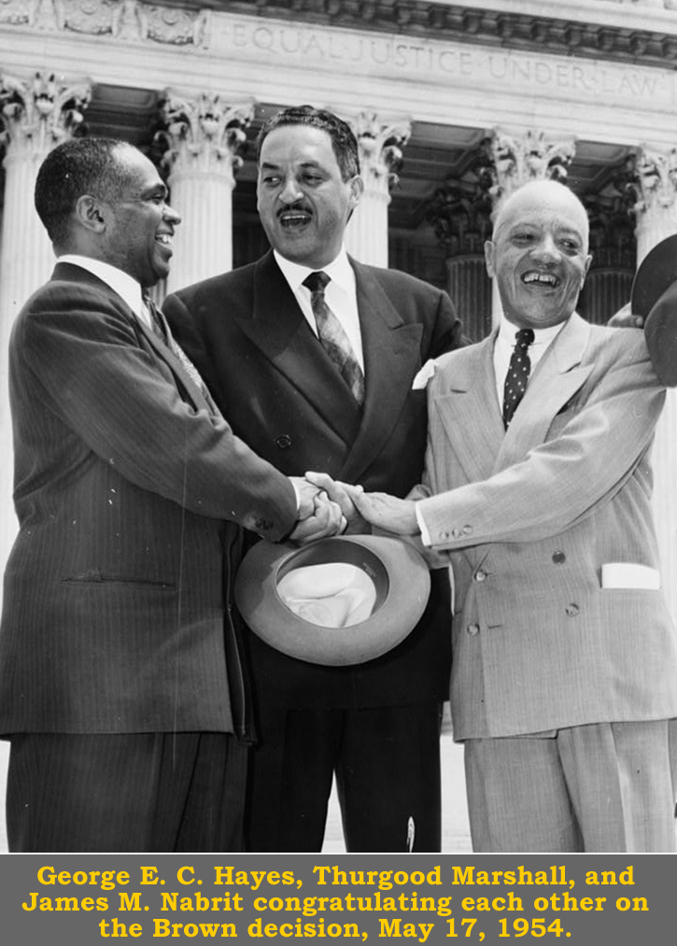
Law & History
Law comprises dense portions of the historical record.
Historically law provided the foundation for stable economies, just societies, and the emergence of democratic states.
Law directly confronts some of society’s most divisive issues: Civil Rights, Reproductive Rights, Labor Organizing, Freedom of Conscience, and so on.

Slide 4
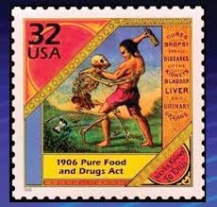
Historical epochs or periods are often demarked in reference to laws and laws mark some of the great historical watersheds.
For instance the Statute of Northampton 2 Edw. 3, ch. 8 (1328) (providing that judges could disregard royal commands that disturbing the common law) is often cited in connection with the rise of an independent judiciary.
Civil Rights Act of 1964 and the Voting Rights Acts of 1965 are often used as historical guideposts marking the end of the Jim Crow era.
The Pure Food and Drugs Act of 1906 marked the end of the Patent Medicine Era.

Slide 5
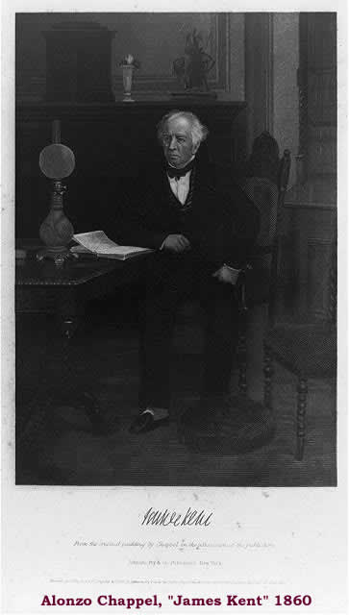
Judicial Decisions reflect a Court’s resolution of a question or questions of law.
Many judicial decisions are published.
Students typically study law by reading carefully selected appellate court decisions.
A student may find themselves being in full agreement with a majority opinion, only to read the dissent to find that she agrees with that too!

Slide 6
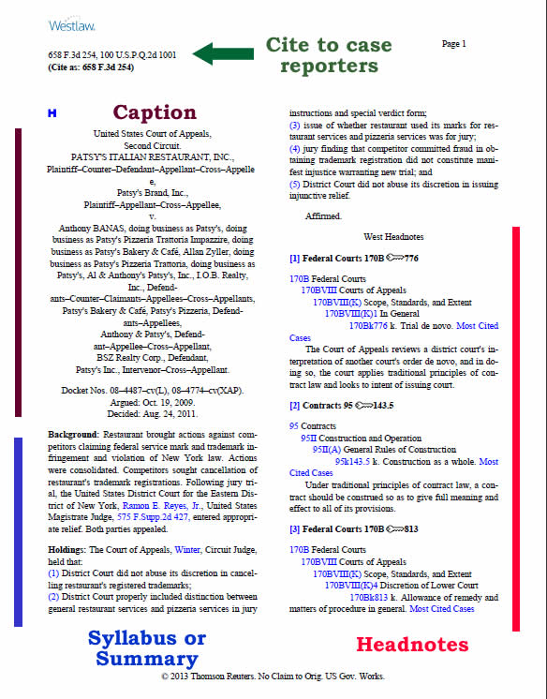
A Published Judicial Decision contains a Caption, a Syllabus (or summary) Headnotes, and the text of the Decision (or decisions if there are Concurrences and Dissents)

Slide 7
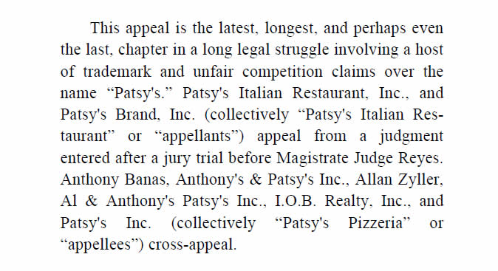

The beginning of the text of judicial decision typically identifies the judge who wrote it:

Slide 8
Citations for Cases identify: (1) the Parties; (2) the Reporter or other collection where the decision can be found; (3) the Court; and (4) the Date the decision was handed down.
People v. Vignera, 15 N.Y.2d 970, 207 N.E.2d 527, 259 N.Y.S.2d 857 (1965).
Westover v. United States, 342 F.2d 684 (9th Cir. 1965).
People v. Stewart, 62 Cal.2d 571, 400 P.2d 97, 43 Cal. Rptr. 201 (1965).
State v. Miranda, 98 Ariz. 18, 401 P.2d 721 (1965).

Slide 9
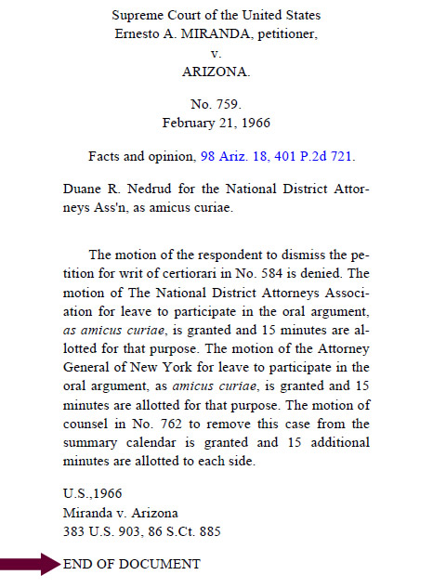

Students may be confused when they encounter memorandum opinions

Slide 10
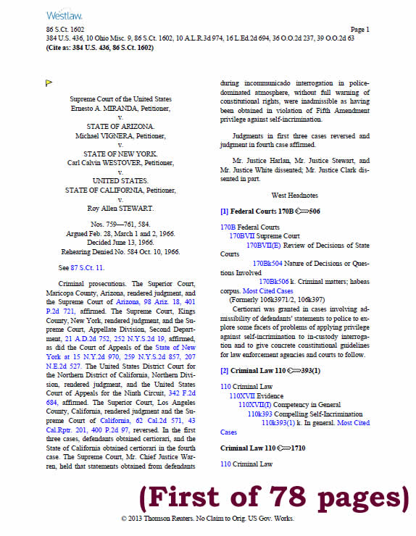

Chances are the students was looking for Miranda v. Arizona, 384 U.S. 436, 86 S. Ct. 1602 (1966) and not Miranda v. Arizona, 383 U.S. 903, 86 S. Ct. 885 (1966) (Mem).

Slide 11
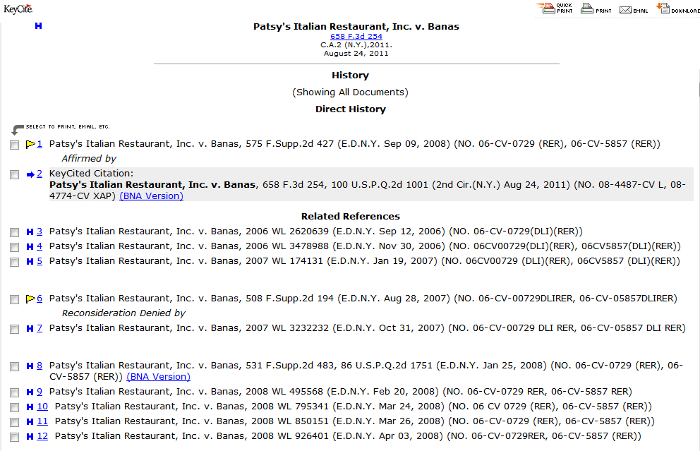
A single case can generate more than one judicial decision.

Slide 12
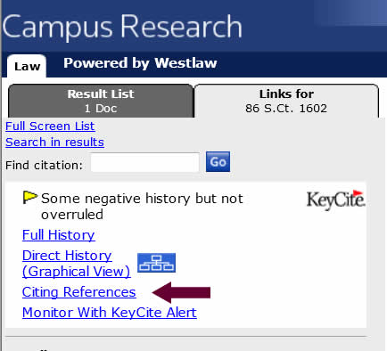
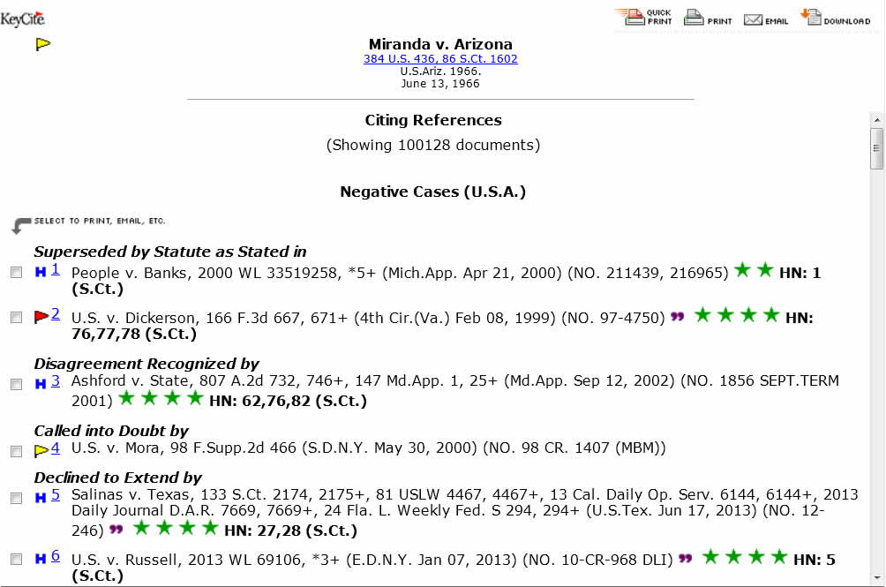
Clicking on Citing References allows you to see (& link to) the documents that cite a decision. Miranda v. Arizona, 384 U.S. 436, is cited more than 100,000 documents.

Slide 13

Are judicial decisions subject to Copyright?

Slide 14
No.
Under 17 U.S.C. § 105, Copyright protection “is not available for any work of the United States Government.”
Wheaton v. Peters, 33 U.S. (8 Pet.) 591, 668, 8 L. Ed. 1055 (1834) (“no reporter has or can have any copyright in the written opinions delivered by this court; and that the judges thereof cannot confer on any reporter any such right”).

Slide 15
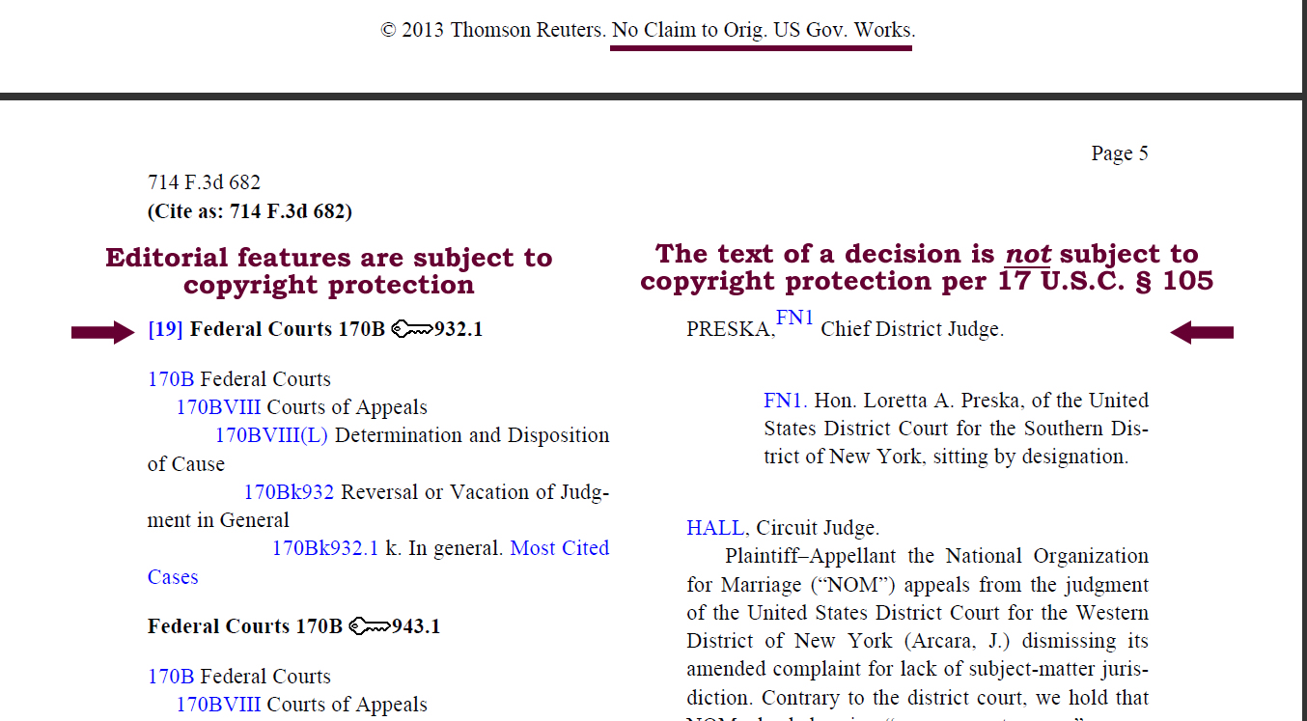
Note that 17 U.S.C. § 105 does not apply to works for hire

Slide 16
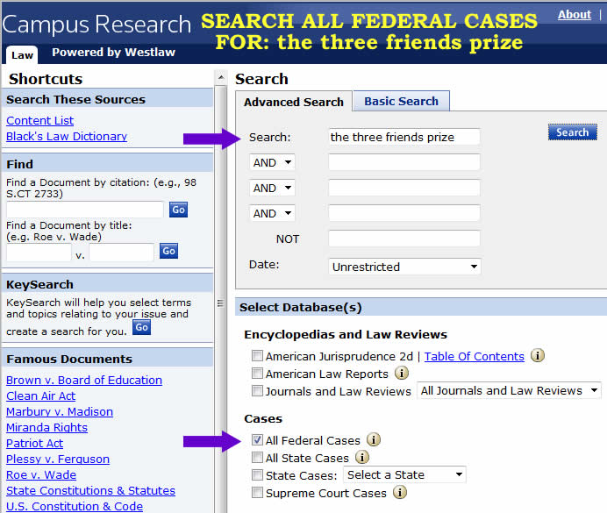
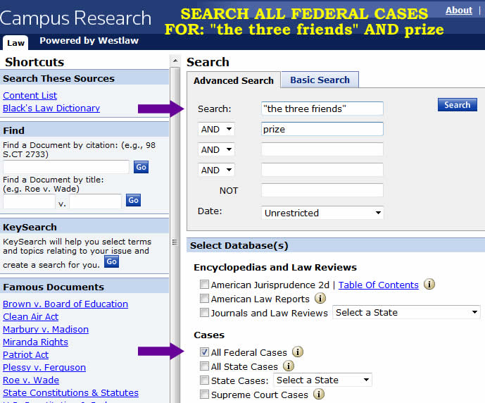
The Default in Westlaw is an “OR” search.
Effective searching requires quotation marks & the AND connector, as we see with a search for The Three Friends, an 1897 prize case.

Slide 17
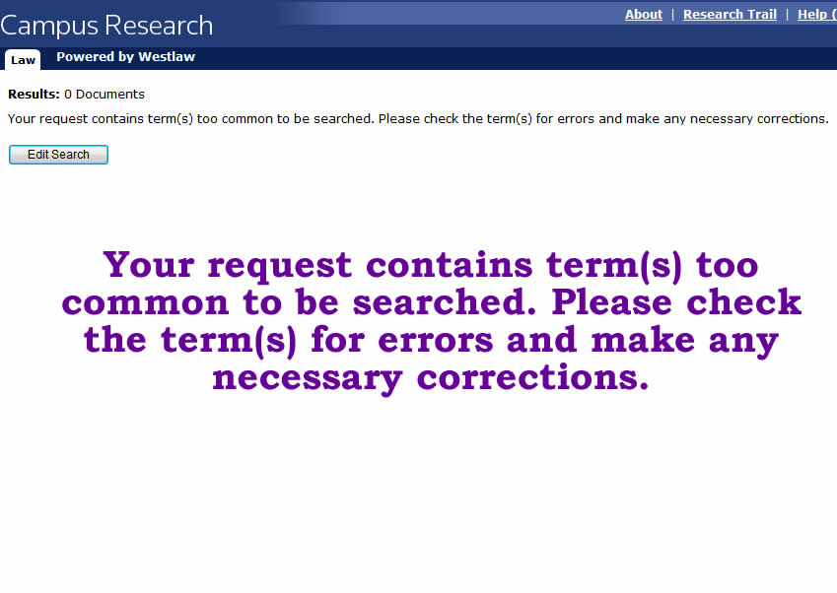
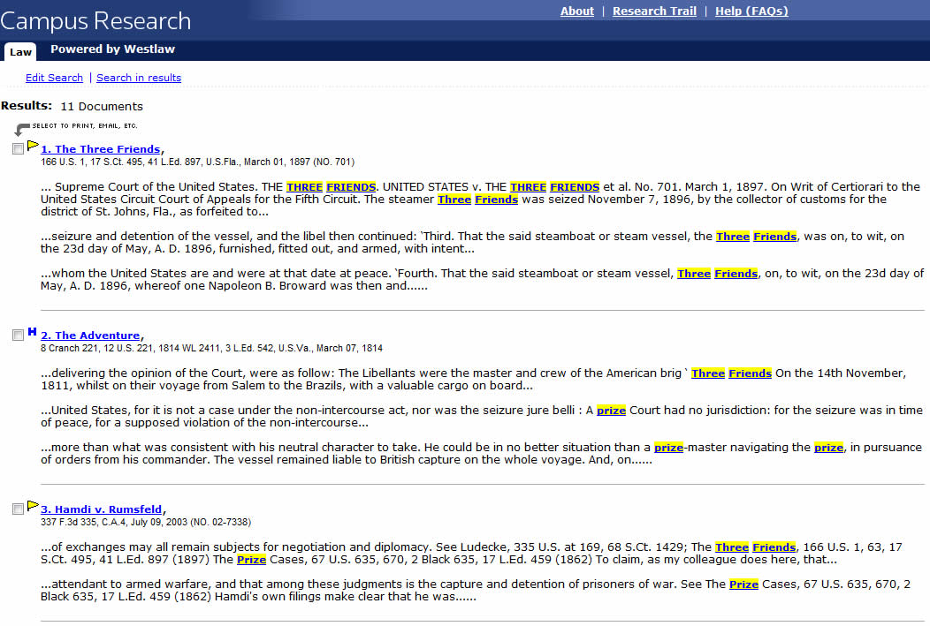
The first search produced no results. The second search produced eleven (11) results including The Three Friends, 166 U.S. 1, 17 S. Ct. 495, 41 L. Ed. 897 (1897).

Slide 18
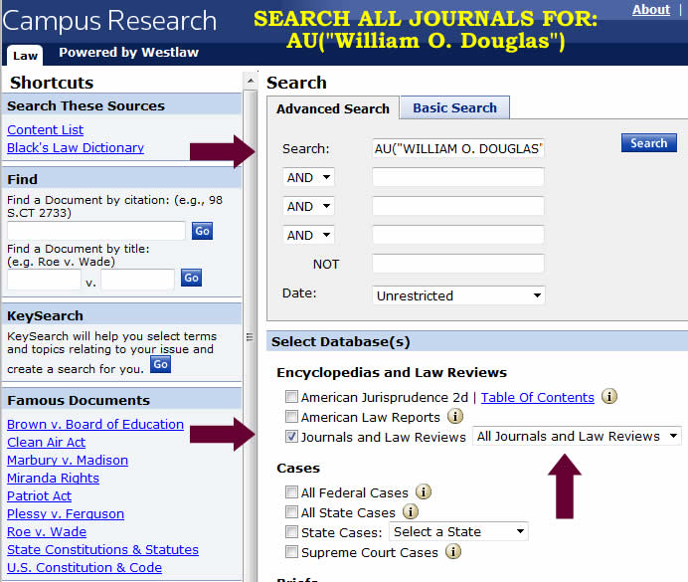
Fields vary by document type and must be composed manually
Journal & Law Review Fields include:
Title - TI()
Author - AU()
Jurisdictions - JU()
Case Law Fields:
Judge - JU()
Concurring - CON()
Dissenting - DIS()
Synopsis - SY()
Digest - DI()
Synopsis/Digest - SY,DI()
Title - TI()
Topic - TO()
Headnote - HE()
Attorney - AT()

Slide 19
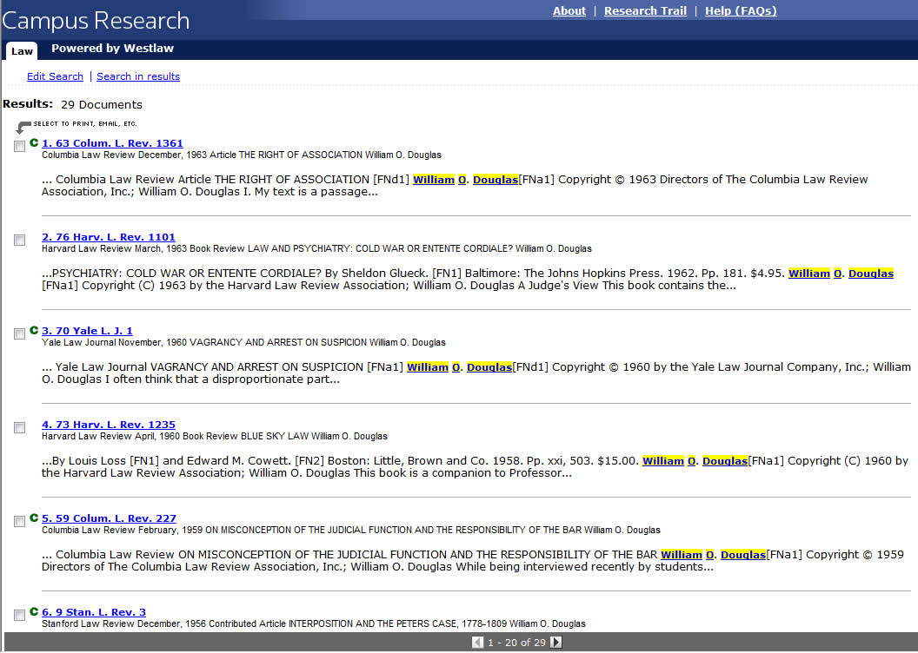
Our search produced twenty-nine (29) results, including William O. Douglas, “The Right of Association,” 63 Colum. L. Rev. 1361 (1963).

Slide 20
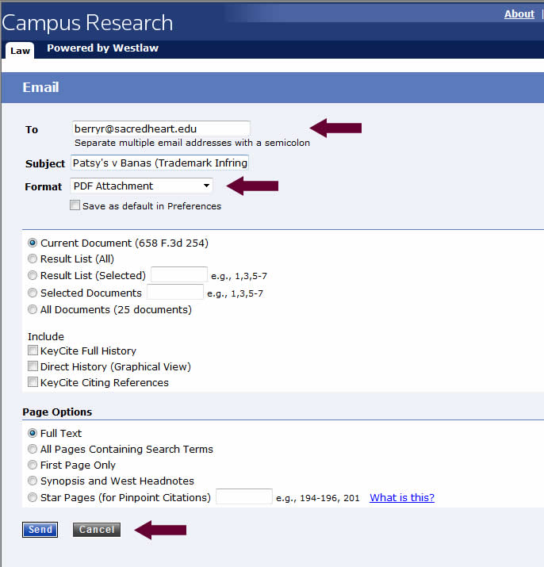
You can e-mail a document in (.doc, .pdf, &c., using Westlaw

Slide 21
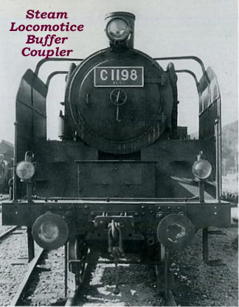
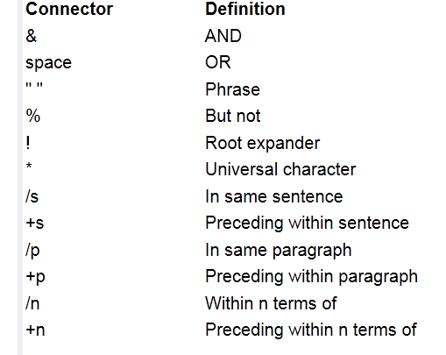
Connectors

Slide 22
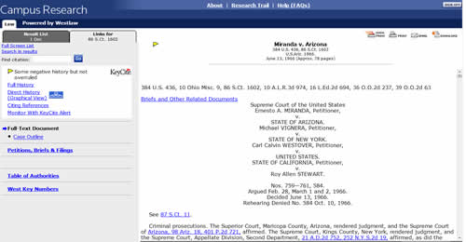
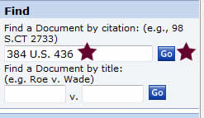
If you know the cite to a reporter you can use the Find feature:

Slide 23
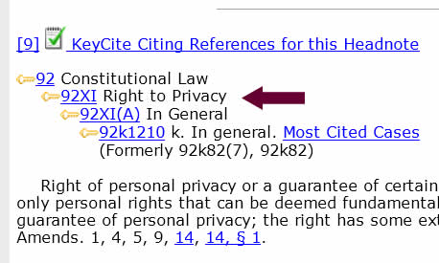
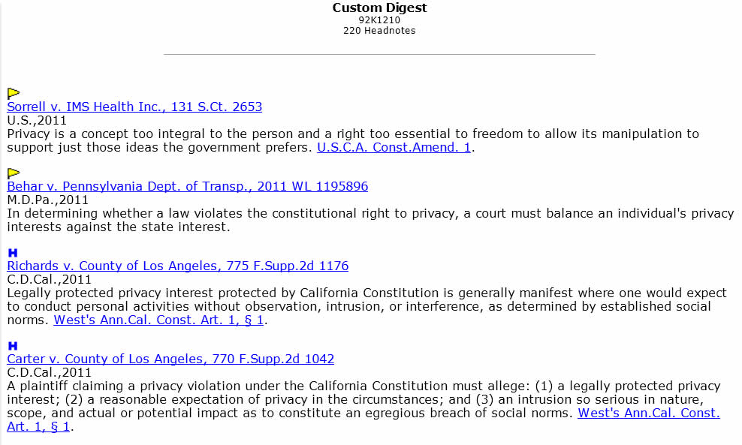
Westlaw links citing and cited documents. West Key Numbers, part of a detailed index of over 110,000 legal topics & sub-topics, are also hyperlinked.

Slide 24
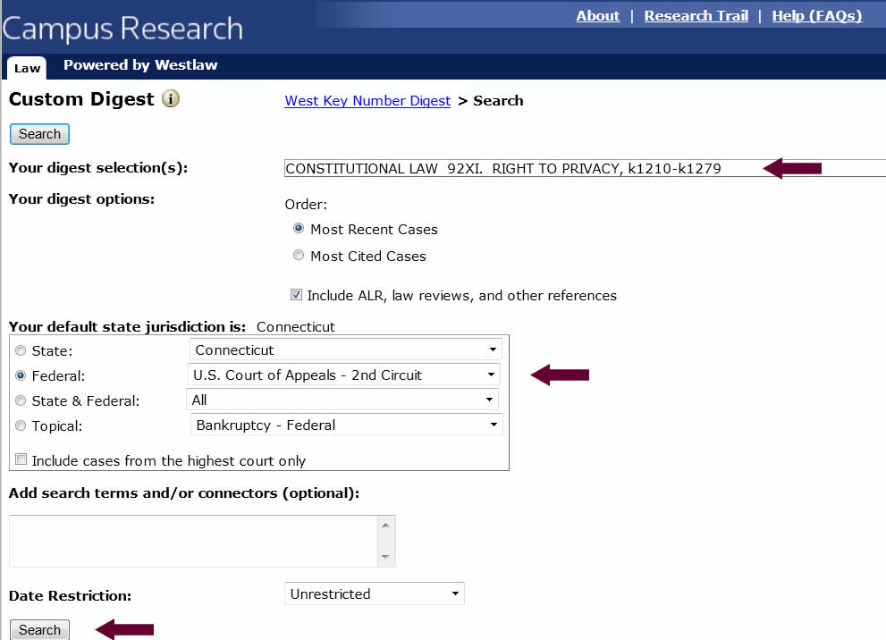
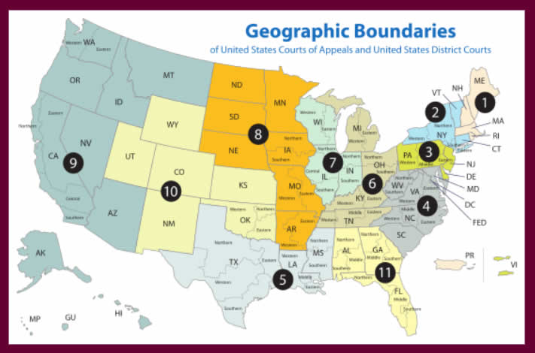
You can use Keycite to limit a search by jurisdiction. Connecticut is in the Second Circuit.

